Slide 1
Least Square
資工三乙 408262143 林采昕

Slide 2
Outline
共同
資料
1 ~ n 次多項式
結論
自訂
資料
1 ~ n 次多項式
結論

Slide 3
共同

Slide 4
 | X | Y |  | X | Y |  | X | Y
1 | 0.02 | 1.0000 | 16 | 2.86 | 1.2799 | 31 | 6.03 | 0.8490
2 | 0.08 | 1.0953 | 17 | 3.14 | 1.6624 | 32 | 6.16 | 0.8983
3 | 0.34 | 1.4789 | 18 | 3.40 | 1.8177 | 33 | 6.32 | 1.0416
4 | 0.45 | 1.6515 | 19 | 3.62 | 1.7875 | 34 | 6.45 | 1.2037
5 | 0.58 | 1.8474 | 20 | 3.88 | 1.6336 | 35 | 6.75 | 1.6859
6 | 0.70 | 1.6978 | 21 | 4.21 | 1.4453 | 36 | 6.95 | 1.9622
7 | 0.82 | 2.0925 | 22 | 4.45 | 1.3483 | 37 | 7.11 | 2.0929
8 | 1.07 | 2.0864 | 23 | 4.53 | 1.3380 | 38 | 7.25 | 2.1259
9 | 1.38 | 1.6978 | 24 | 4.71 | 1.3333 | 39 | 7.51 | 1.9403
10 | 1.68 | 1.1256 | 25 | 5.03 | 1.3089 | 40 | 7.73 | 1.5788
11 | 1.80 | 0.8946 | 26 | 5.18 | 1.2579 | 41 | 8.02 | 1.0083
12 | 1.93 | 0.7072 | 27 | 5.31 | 1.1916 | 42 | 8.16 | 0.7795
13 | 2.23 | 0.5426 | 28 | 5.43 | 1.1165 | 43 | 8.38 | 0.5662
14 | 2.50 | 0.7396 | 29 | 5.54 | 1.0414 | 44 | 8.61 | 0.5793
15 | 2.71 | 1.0428 | 30 | 5.80 | 0.8835 | 45 | 8.75 | 0.6747

Slide 5
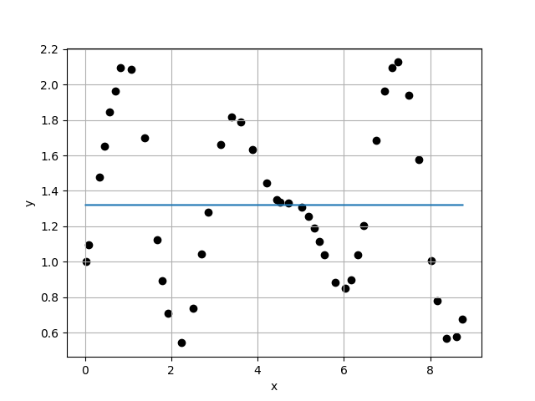
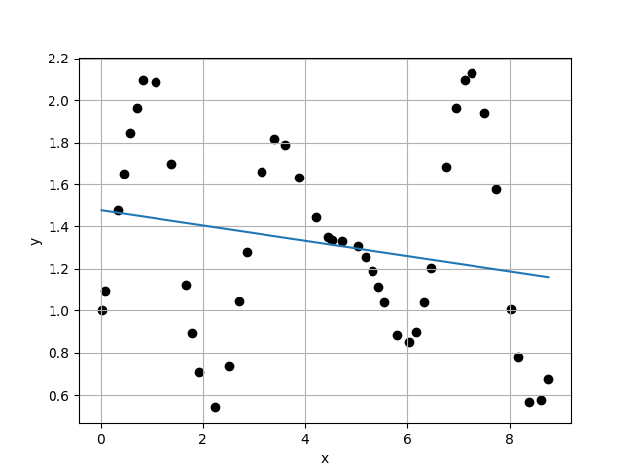
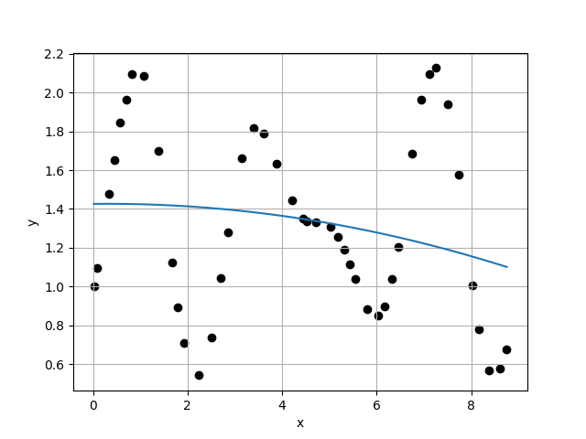
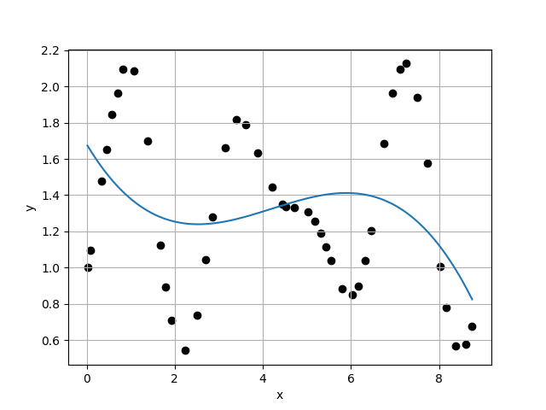








Case 1 :
Case 2 :
f(x) = 1.3200E+00
f(x) = 1.4772E+00 - 3.6178E-02 * x
$σ_{k}=$4.6732E-01
$σ_{k}=$4.6243E-01
$\frac{σ_{k}}{σ_{k+1}}=$1.0106E+00
$\frac{σ_{k}}{σ_{k+1}}=$9.9023E-01
Case 3 :
f(x) = 1.4260E+00 + 2.8636E-03 * x - 4.5716E-03 * x^2
Case 4 :
f(x) = 1.6814E+00 - 4.0739E-01 * x + 1.1501E-01 * x^2 - 9.1013E-03 * x^3
$σ_{k}=$4.6699E-01
$σ_{k}=$4.5387E-01
$\frac{σ_{k}}{σ_{k+1}}=$1.0289E+00
$\frac{σ_{k}}{σ_{k+1}}=$1.0526E+00

Slide 6
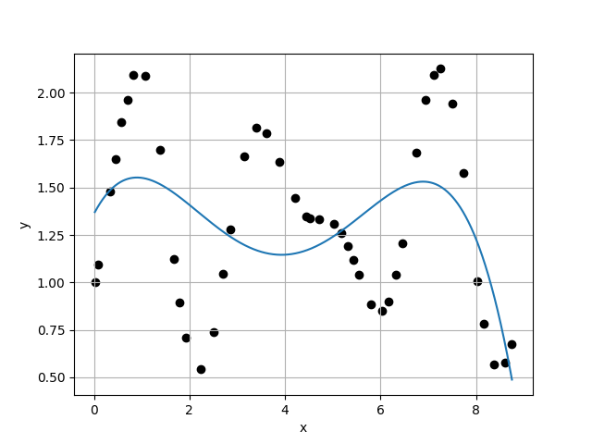
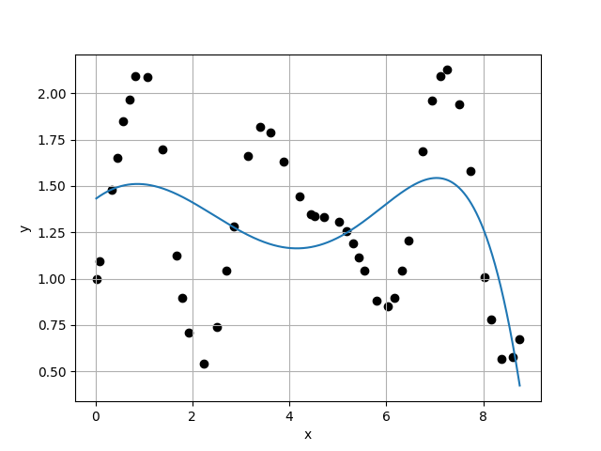
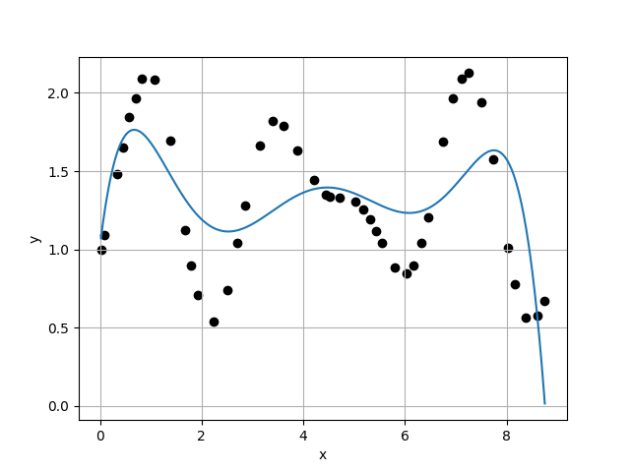
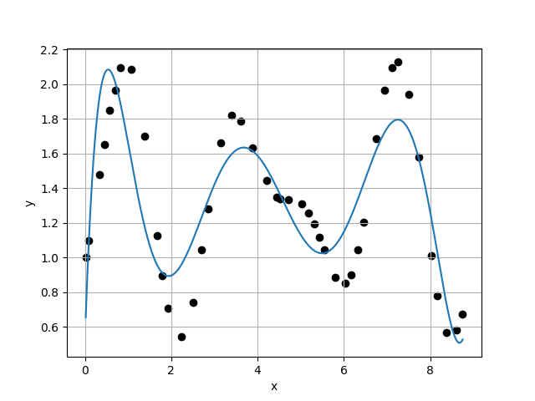








Case 5 :
Case 6 :
f(x) = 1.3611E+00 + 4.8095E-01 * x - 3.6301E-01 * x^2 + 7.7062E-02 * x^3 - 4.9326E-03 * x^4
f(x) = 1.4285E+00 + 1.9678E-01 * x - 1.2338E-01 * x^2 + 2.8552E-03 * x^3 + 4.6400E-03 * x^4 - 4.3659E-04 * x^5
$σ_{k}=$4.3121E-01
$σ_{k}=$4.3553E-01
$\frac{σ_{k}}{σ_{k+1}}=$9.9007E-01
$\frac{σ_{k}}{σ_{k+1}}=$1.1226E+00
Case 7 :
f(x) = 1.0190E+00 + 2.7100E+00 * x - 3.2470E+00 * x^2 + 1.4870E+00 * x^3 - 3.1961E-01 * x^4 + 3.2487E-02 * x^5 - 1.2590E-03 * x^6
Case 8 :
f(x) = 5.1413E-01 + 7.2331E+00 * x - 1.1132E+01 * x^2 + 6.7832E+00 * x^3 - 2.0319E+00 * x^4 + 3.1839E-01 * x^5 - 2.5021E-02 * x^6 + 7.7774E-04 * x^7
$σ_{k}=$3.8798E-01
$σ_{k}=$2.6512E-01
$\frac{σ_{k}}{σ_{k+1}}=$1.4634E+00
$\frac{σ_{k}}{σ_{k+1}}=$1.4120E+00

Slide 7
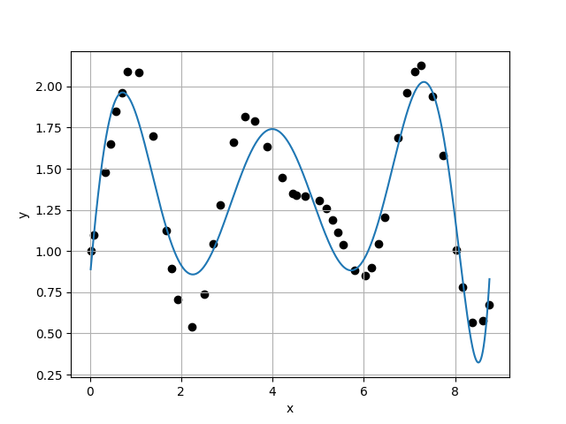
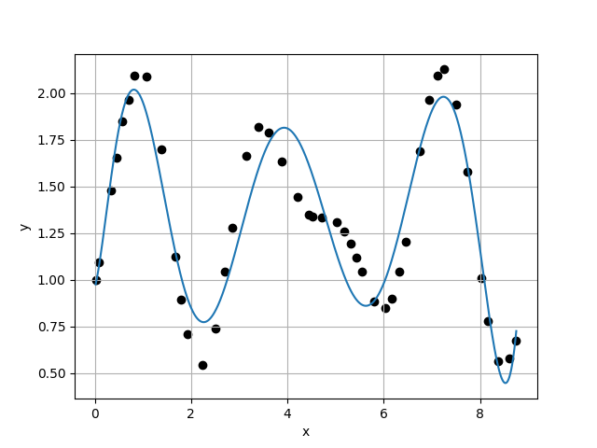
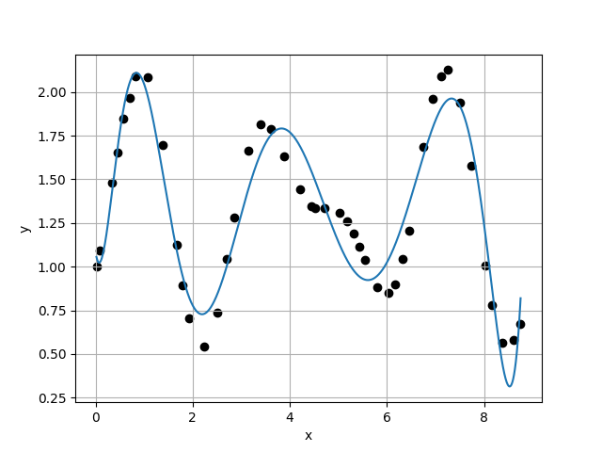
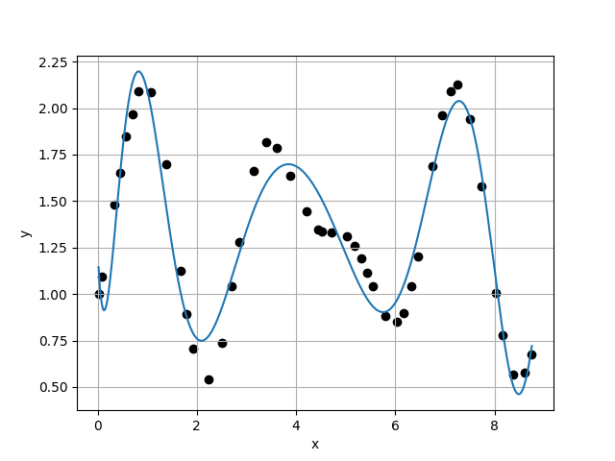








Case 9 :
Case 10 :
f(x) = 8.2613E-01 + 3.2037E+00 * x - 1.8051E+00 * x^2 - 1.5566E+00 * x^3 + 1.6610E+00 * x^4 - 5.7466E-01 * x^5 + 9.5088E-02 * x^6 - 7.6567E-03 * x^7 + 2.4107E-04 * x^8
f(x) = 9.5304E-01 + 1.0175E+00 * x + 4.4821E+00 * x^2 - 8.6330E+00 * x^3 + 5.7024E+00 * x^4 - 1.8830E+00 * x^5 + 3.4550E-01 * x^6 - 3.5716E-02 * x^7 + 1.9422E-03 * x^8 - 4.3076E-05 * x^9
$σ_{k}=$1.8776E-01
$σ_{k}=$1.7596E-01
$\frac{σ_{k}}{σ_{k+1}}=$1.0671E+00
$\frac{σ_{k}}{σ_{k+1}}=$1.0695E+00
Case 11 :
f(x) = 1.0858E+00 - 1.7702E+00 * x + 1.4025E+01 * x^2 - 2.1718E+01 * x^3 + 1.5014E+01 * x^4 - 5.7427E+00 * x^5 + 1.3287E+00 * x^6 - 1.9172E-01 * x^7 + 1.6969E-02 * x^8 - 8.4711E-04 * x^9 + 1.8328E-05 * x^10
Case 12 :
f(x) = 1.2479E+00 - 5.7628E+00 * x + 3.0197E+01 * x^2 - 4.8526E+01 * x^3 + 3.8422E+01 * x^4 - 1.7853E+01 * x^5 + 5.2719E+00 * x^6 - 1.0216E+00 * x^7 + 1.2967E-01 * x^8 - 1.0380E-02 * x^9 + 4.7514E-04 * x^10 - 9.4693E-06 * x^11
$σ_{k}=$1.6453E-01
$σ_{k}=$1.4735E-01
$\frac{σ_{k}}{σ_{k+1}}=$1.1166E+00
$\frac{σ_{k}}{σ_{k+1}}=$1.3013E+00

Slide 8
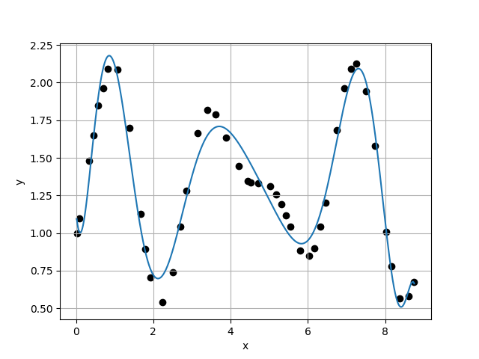
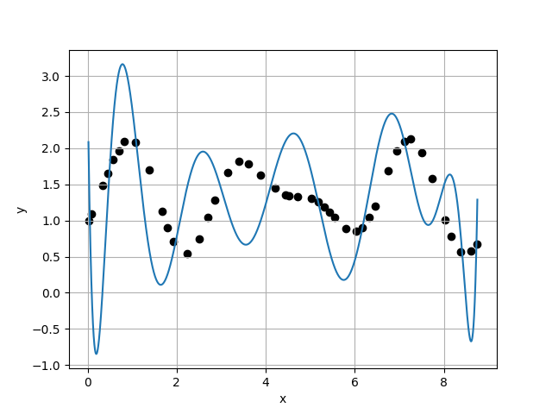
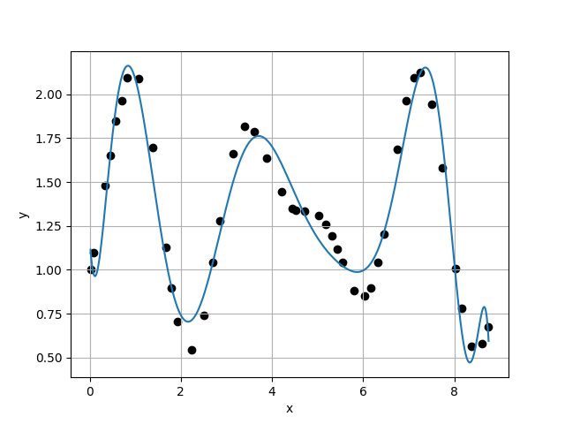
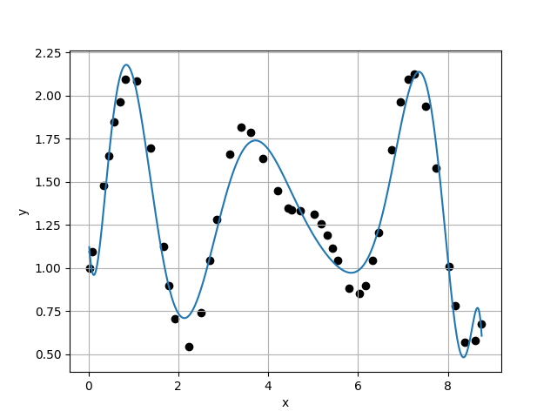








Case 13 :
f(x) = 1.1439E+00 - 2.8204E+00 * x + 1.6112E+01 * x^2 - 2.0557E+01 * x^3 + 8.9268E+00 * x^4 + 7.7599E-01 * x^5 - 2.2544E+00 * x^6 + 9.9205E-01 * x^7 - 2.3123E-01 * x^8 + 3.2470E-02 * x^9 - 2.7586E-03 * x^10 + 1.3096E-04 * x^11 - 2.6715E-06 * x^12
Case 14 :
f(x) = 2.9550E+00 - 4.7223E+01 * x + 1.9227E+02 * x^2 - 2.9697E+02 * x^3 + 2.2073E+02 * x^4 - 7.8290E+01 * x^5 + 4.1742E+00 * x^6 + 7.6684E+00 * x^7 - 3.4137E+00 * x^8 + 7.4949E-01 * x^9 - 9.8323E-02 * x^10 + 7.8159E-03 * x^11 - 3.4852E-04 * x^12 + 6.7081E-06 * x^13
$σ_{k}=$1.1324E-01
$σ_{k}=$8.9219E-01
$\frac{σ_{k}}{σ_{k+1}}=$1.2692E-01
$\frac{σ_{k}}{σ_{k+1}}=$6.6053E+00
Case 15 :
f(x) = 1.1915E+00 - 4.3549E+00 * x + 2.5018E+01 * x^2 - 4.2076E+01 * x^3 + 3.6416E+01 * x^4 - 2.0113E+01 * x^5 + 7.8157E+00 * x^6 - 2.1848E+00 * x^7 + 4.2588E-01 * x^8 - 5.3099E-02 * x^9 + 3.2137E-03 * x^10 + 1.0129E-04 * x^11 - 3.3074E-05 * x^12 + 2.2509E-06 * x^13 - 5.4716E-08 * x^14
Case 16 :
f(x) = 1.1993E+00 - 4.4289E+00 * x + 2.4390E+01 * x^2 - 3.8563E+01 * x^3 + 2.9917E+01 * x^4 - 1.3885E+01 * x^5 + 4.2362E+00 * x^6 - 8.6642E-01 * x^7 + 1.0676E-01 * x^8 - 2.9895E-03 * x^9 - 1.4743E-03 * x^10 + 2.6741E-04 * x^11 - 1.8395E-05 * x^12 + 1.1367E-07 * x^13 + 5.0999E-08 * x^14 - 1.9737E-09 * x^15
$σ_{k}=$1.3507E-01
$σ_{k}=$1.3624E-01
$\frac{σ_{k}}{σ_{k+1}}=$9.9143E-01
$\frac{σ_{k}}{σ_{k+1}}=$1.2006E+00

Slide 9
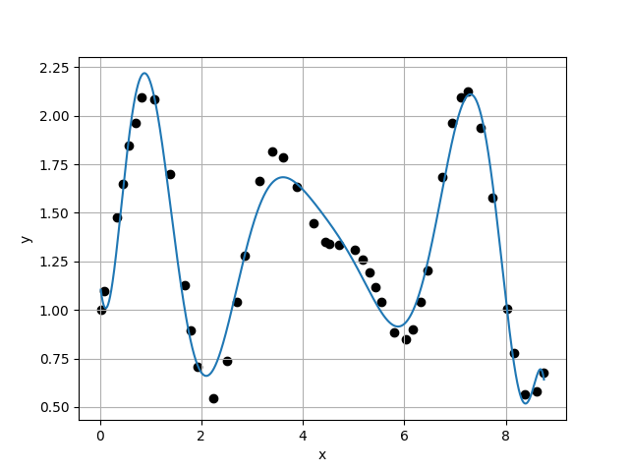
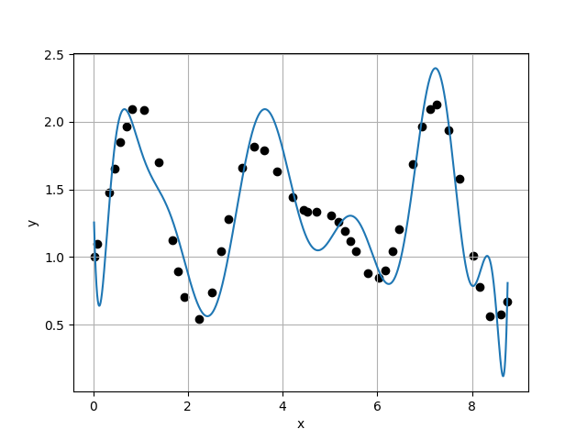
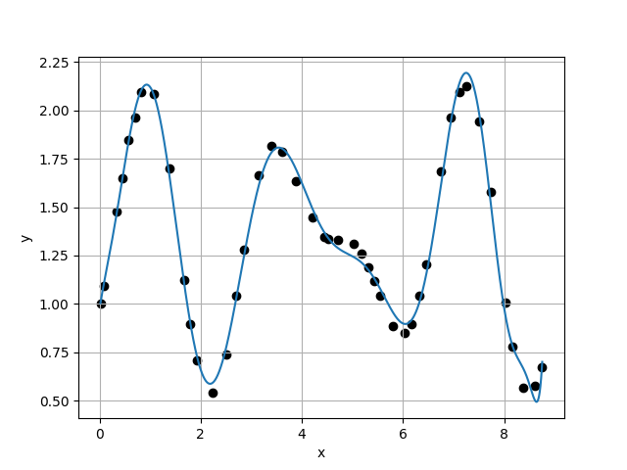
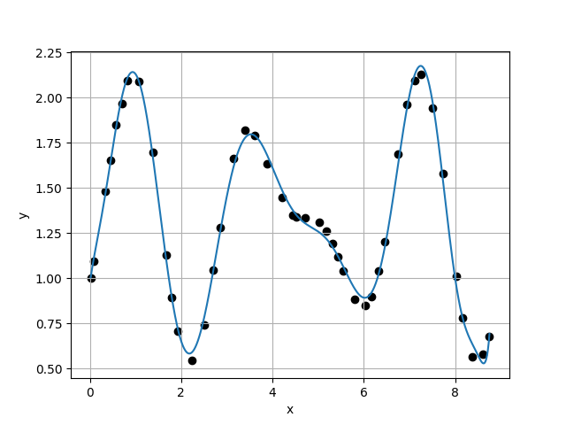








Case 17 :
Case 18 :
f(x) = 1.1507E+00 - 2.5800E+00 * x + 1.3120E+01 * x^2 - 1.1683E+01 * x^3 - 2.4873E+00 * x^4 + 8.3826E+00 * x^5 - 4.8962E+00 * x^6 + 1.2948E+00 * x^7 - 1.1216E-01 * x^8 - 2.6698E-02 * x^9 + 8.9034E-03 * x^10 - 9.5171E-04 * x^11 - 1.9489E-06 * x^12 + 1.1176E-05 * x^13 - 1.2227E-06 * x^14 + 5.8961E-08 * x^15 - 1.1311E-09 * x^16
f(x) = 1.5568E+00 - 1.7003E+01 * x + 1.0320E+02 * x^2 - 2.4048E+02 * x^3 + 3.0030E+02 * x^4 - 2.2763E+02 * x^5 + 1.1066E+02 * x^6 - 3.5198E+01 * x^7 + 7.2338E+00 * x^8 - 8.9182E-01 * x^9 + 4.6054E-02 * x^10 + 3.6542E-03 * x^11 - 9.3946E-04 * x^12 + 1.1646E-04 * x^13 - 1.3153E-05 * x^14 + 1.1743E-06 * x^15 - 6.1611E-08 * x^16 + 1.3584E-09 * x^17
$σ_{k}=$1.1347E-01
$σ_{k}=$2.7911E-01
$\frac{σ_{k}}{σ_{k+1}}=$4.0655E-01
$\frac{σ_{k}}{σ_{k+1}}=$5.0738E+00
Case 19 :
f(x) = 9.7055E-01 + 1.7378E+00 * x - 3.1933E+00 * x^2 + 1.1696E+01 * x^3 - 1.7404E+01 * x^4 + 1.1619E+01 * x^5 - 3.8903E+00 * x^6 + 5.9932E-01 * x^7 - 6.6405E-03 * x^8 - 9.0267E-03 * x^9 + 4.3736E-04 * x^10 + 1.1965E-04 * x^11 - 1.3066E-05 * x^12 + 1.1409E-06 * x^13 - 2.5799E-07 * x^14 + 1.4442E-08 * x^15 + 2.6265E-09 * x^16 - 3.4320E-10 * x^17 + 1.1322E-11 * x^18
Case 20 :
f(x) = 9.6785E-01 + 1.8723E+00 * x - 4.0521E+00 * x^2 + 1.3606E+01 * x^3 - 1.9275E+01 * x^4 + 1.2392E+01 * x^5 - 3.8588E+00 * x^6 + 4.3725E-01 * x^7 + 6.1604E-02 * x^8 - 2.2206E-02 * x^9 + 1.5062E-03 * x^10 + 1.3113E-04 * x^11 - 1.6118E-05 * x^12 + 5.6144E-07 * x^13 - 2.6711E-07 * x^14 + 2.1608E-08 * x^15 + 5.1231E-09 * x^16 - 9.2345E-10 * x^17 + 5.4083E-11 * x^18 - 1.1064E-12 * x^19
$σ_{k}=$5.5010E-02
$σ_{k}=$4.4553E-02
$\frac{σ_{k}}{σ_{k+1}}=$1.2347E+00
$\frac{σ_{k}}{σ_{k+1}}=$3.6640E-01

Slide 10
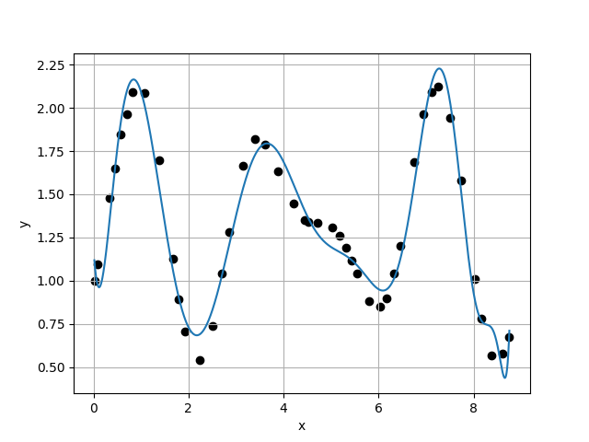
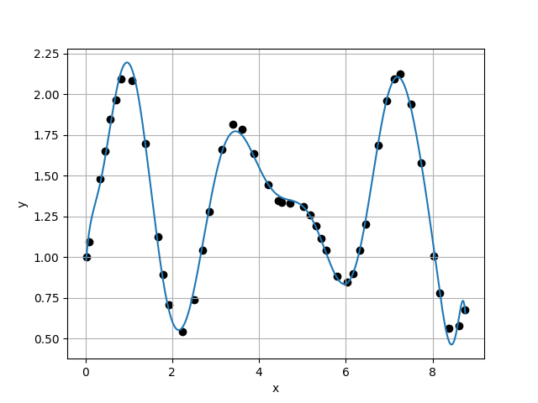
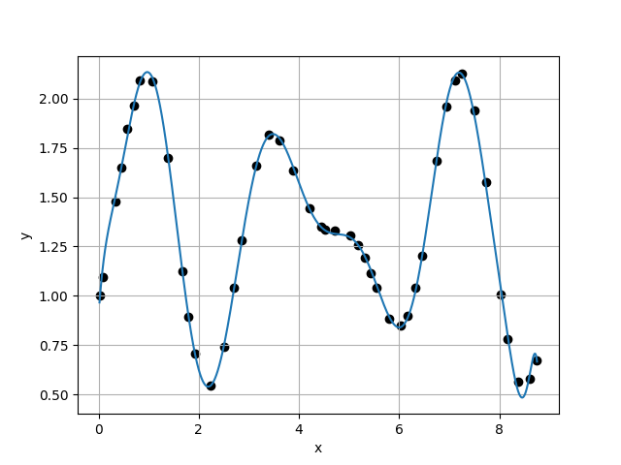
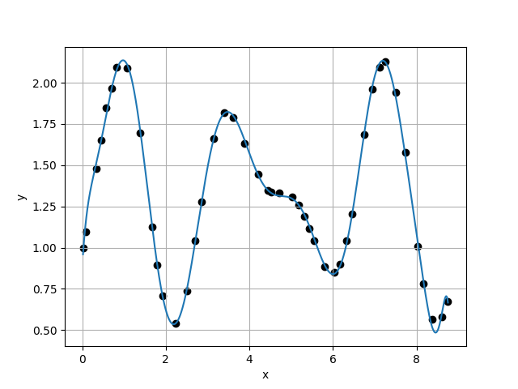








Case 21 :
Case 22 :
f(x) = 1.1971E+00 - 4.4352E+00 * x + 2.5143E+01 * x^2 - 4.1765E+01 * x^3 + 3.5107E+01 * x^4 - 1.8082E+01 * x^5 + 6.0795E+00 * x^6 - 1.2962E+00 * x^7 + 1.4852E-01 * x^8 - 2.5290E-03 * x^9 - 1.0919E-03 * x^10 - 1.1200E-05 * x^11 + 2.4294E-05 * x^12 - 2.4062E-06 * x^13 + 3.9689E-08 * x^14 + 5.3569E-08 * x^15 - 1.5099E-08 * x^16 + 1.6505E-09 * x^17 - 5.6588E-11 * x^18 - 2.1302E-12 * x^19 + 1.4161E-13 * x^20
f(x) = 9.1130E-01 + 3.9883E+00 * x - 1.7658E+01 * x^2 + 4.9207E+01 * x^3 - 6.8607E+01 * x^4 + 5.3836E+01 * x^5 - 2.6621E+01 * x^6 + 8.9204E+00 * x^7 - 2.0892E+00 * x^8 + 3.3115E-01 * x^9 - 2.9397E-02 * x^10 - 3.6985E-05 * x^11 + 2.8155E-04 * x^12 - 9.0924E-06 * x^13 - 3.4722E-06 * x^14 + 3.1329E-07 * x^15 + 1.0882E-08 * x^16 - 2.5194E-09 * x^17 + 1.6047E-10 * x^18 - 1.6530E-11 * x^19 + 1.4518E-12 * x^20 - 4.5826E-14 * x^21
$σ_{k}=$1.2159E-01
$σ_{k}=$4.9168E-02
$\frac{σ_{k}}{σ_{k+1}}=$2.4730E+00
$\frac{σ_{k}}{σ_{k+1}}=$1.6871E+00
Case 23 :
f(x) = 8.9555E-01 + 3.7718E+00 * x - 1.2220E+01 * x^2 + 2.7663E+01 * x^3 - 3.1421E+01 * x^4 + 1.8109E+01 * x^5 - 5.3070E+00 * x^6 + 6.0390E-01 * x^7 + 5.9007E-02 * x^8 - 2.1808E-02 * x^9 + 1.1722E-03 * x^10 + 1.3100E-04 * x^11 - 7.6800E-06 * x^12 - 8.5752E-07 * x^13 + 1.0231E-07 * x^14 - 1.6236E-08 * x^15 - 1.1984E-09 * x^16 + 3.6072E-10 * x^17 + 4.1009E-11 * x^18 - 6.4732E-12 * x^19 - 5.6029E-13 * x^20 + 1.0455E-13 * x^21 - 3.7802E-15 * x^22
Case 24 :
f(x) = 8.8130E-01 + 4.1687E+00 * x - 1.4157E+01 * x^2 + 3.1708E+01 * x^3 - 3.6081E+01 * x^4 + 2.1473E+01 * x^5 - 6.9460E+00 * x^6 + 1.1649E+00 * x^7 - 7.6380E-02 * x^8 - 2.1857E-04 * x^9 - 4.8523E-04 * x^10 + 1.5673E-05 * x^11 + 2.9020E-05 * x^12 - 1.2468E-06 * x^13 - 6.3182E-07 * x^14 + 6.3757E-08 * x^15 - 2.5137E-11 * x^16 - 8.9329E-11 * x^17 + 1.5577E-12 * x^18 + 4.2028E-13 * x^19 - 3.0868E-13 * x^20 + 1.4666E-14 * x^21 + 1.9430E-15 * x^22 - 1.2318E-16 * x^23
$σ_{k}=$2.9143E-02
$σ_{k}=$3.1522E-02
$\frac{σ_{k}}{σ_{k+1}}=$9.2454E-01
$\frac{σ_{k}}{σ_{k+1}}=$3.1180E-01

Slide 11
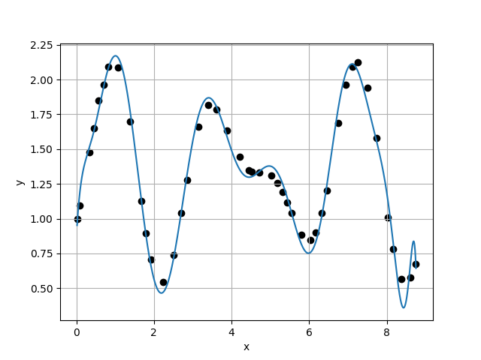
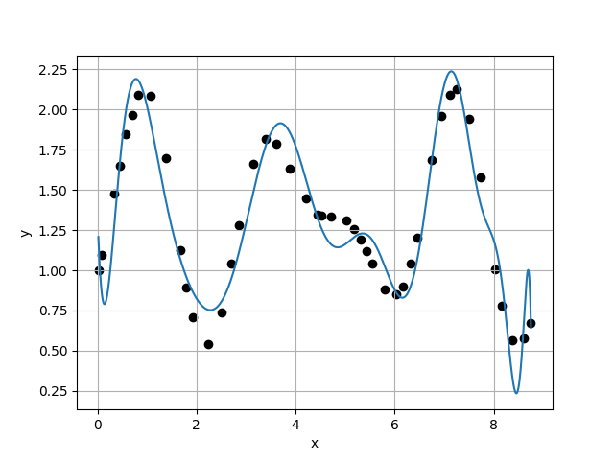
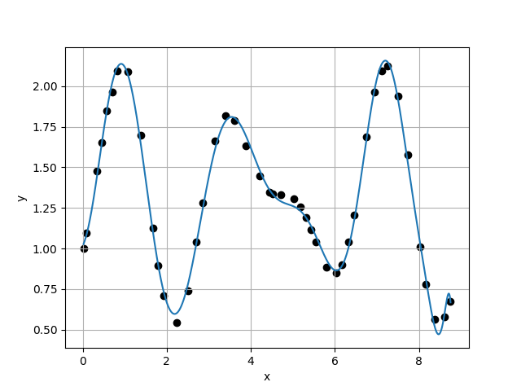
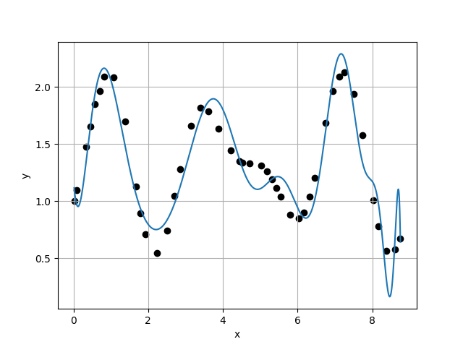








Case 25 :
f(x) = 8.5895E-01 + 5.0363E+00 * x - 1.8938E+01 * x^2 + 4.2014E+01 * x^3 - 4.8118E+01 * x^4 + 3.1058E+01 * x^5 - 1.2940E+01 * x^6 + 4.0977E+00 * x^7 - 1.1019E+00 * x^8 + 2.3001E-01 * x^9 - 2.7932E-02 * x^10 + 3.7983E-04 * x^11 + 2.8818E-04 * x^12 - 8.2058E-07 * x^13 - 6.7785E-06 * x^14 + 5.0416E-07 * x^15 + 3.8156E-08 * x^16 - 3.3527E-09 * x^17 - 5.6966E-10 * x^18 + 6.1033E-11 * x^19 + 5.4968E-12 * x^20 - 1.5455E-12 * x^21 + 1.4053E-13 * x^22 - 6.2289E-15 * x^23 + 1.1101E-16 * x^24
Case 26 :
f(x) = 1.3827E+00 - 9.7435E+00 * x + 5.0491E+01 * x^2 - 9.0205E+01 * x^3 + 8.0841E+01 * x^4 - 4.0314E+01 * x^5 + 1.0545E+01 * x^6 - 7.1548E-01 * x^7 - 3.3884E-01 * x^8 + 8.4478E-02 * x^9 - 2.3990E-03 * x^10 - 1.2888E-03 * x^11 + 1.2216E-04 * x^12 - 7.1100E-08 * x^13 + 6.8824E-07 * x^14 - 8.7698E-08 * x^15 - 1.3675E-08 * x^16 + 2.3808E-09 * x^17 - 3.0988E-10 * x^18 + 2.9268E-11 * x^19 + 1.1440E-12 * x^20 - 4.5400E-14 * x^21 - 5.1554E-14 * x^22 + 3.3932E-15 * x^23 + 1.4127E-16 * x^24 - 1.1861E-17 * x^25
$σ_{k}=$1.0110E-01
$σ_{k}=$2.1766E-01
$\frac{σ_{k}}{σ_{k+1}}=$4.6446E-01
$\frac{σ_{k}}{σ_{k+1}}=$4.0591E+00
Case 27 :
f(x) = 1.0147E+00 + 5.6445E-01 * x + 2.0900E+00 * x^2 + 1.9521E+00 * x^3 - 8.2328E+00 * x^4 + 6.9494E+00 * x^5 - 2.7490E+00 * x^6 + 6.0803E-01 * x^7 - 8.8290E-02 * x^8 + 1.1196E-02 * x^9 - 1.1851E-03 * x^10 + 3.3573E-05 * x^11 + 2.0308E-06 * x^12 + 1.7674E-06 * x^13 - 2.8748E-07 * x^14 - 2.9132E-10 * x^15 + 2.4480E-09 * x^16 - 2.3244E-10 * x^17 + 1.8818E-11 * x^18 - 2.4406E-12 * x^19 + 4.4033E-13 * x^20 - 3.7353E-14 * x^21 + 1.0476E-15 * x^22 + 2.3789E-17 * x^23 - 3.6582E-17 * x^24 + 5.6206E-18 * x^25 - 2.3306E-19 * x^26
Case 28 :
f(x) = 1.1953E+00 - 4.4275E+00 * x + 2.3934E+01 * x^2 - 3.4569E+01 * x^3 + 1.9460E+01 * x^4 - 1.2458E+00 * x^5 - 4.0135E+00 * x^6 + 2.1851E+00 * x^7 - 5.0269E-01 * x^8 + 4.4499E-02 * x^9 + 1.2082E-03 * x^10 - 1.2695E-05 * x^11 - 1.0498E-04 * x^12 + 7.5137E-06 * x^13 + 5.7773E-08 * x^14 + 1.5625E-07 * x^15 - 1.6533E-08 * x^16 - 3.1916E-10 * x^17 - 1.5975E-10 * x^18 + 1.4347E-11 * x^19 + 2.7873E-12 * x^20 - 8.9513E-14 * x^21 - 1.4520E-14 * x^22 - 8.7470E-16 * x^23 + 7.3877E-17 * x^24 - 1.1947E-17 * x^25 + 2.9737E-18 * x^26 - 1.5001E-19 * x^27
$σ_{k}=$5.3623E-02
$σ_{k}=$2.3163E-01
$\frac{σ_{k}}{σ_{k+1}}=$2.3151E-01
$\frac{σ_{k}}{σ_{k+1}}=$1.8934E+00

Slide 12
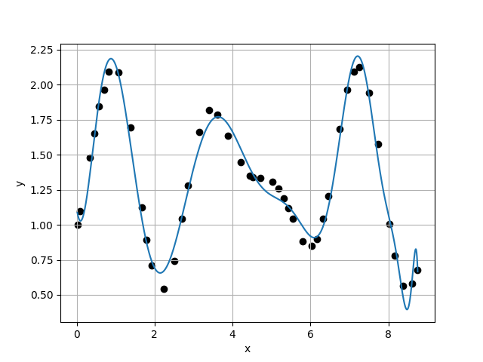
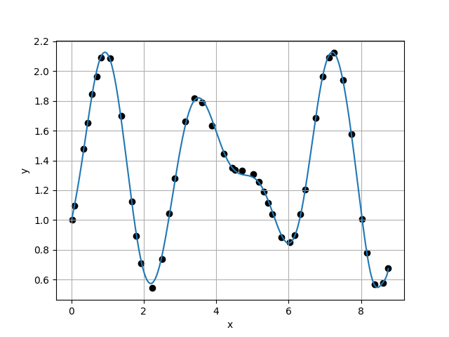
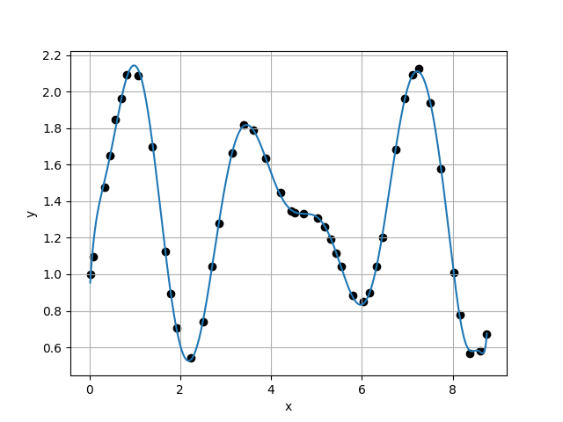
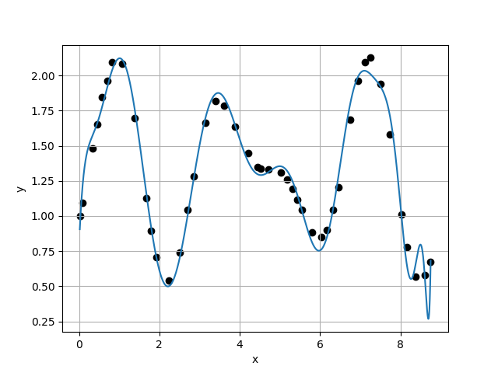








Case 29 :
Case 30 :
f(x) = 1.1211E+00 - 1.9719E+00 * x + 1.1467E+01 * x^2 - 1.0653E+01 * x^3 - 1.7922E+00 * x^4 + 7.4007E+00 * x^5 - 4.6269E+00 * x^6 + 1.3915E+00 * x^7 - 1.9586E-01 * x^8 - 1.6736E-03 * x^9 + 4.7788E-03 * x^10 - 6.0289E-04 * x^11 + 1.5608E-05 * x^12 - 1.9100E-07 * x^13 + 5.1302E-07 * x^14 - 3.7296E-08 * x^15 - 6.9538E-09 * x^16 + 8.0144E-10 * x^17 + 6.3412E-11 * x^18 - 5.0391E-12 * x^19 - 1.5020E-12 * x^20 - 1.0370E-14 * x^21 + 3.0413E-14 * x^22 - 9.9135E-16 * x^23 + 1.2092E-16 * x^24 - 5.9363E-17 * x^25 + 4.6642E-18 * x^26 + 1.0094E-20 * x^27 - 7.5858E-21 * x^28
f(x) = 9.8686E-01 + 1.2224E+00 * x - 1.6485E-01 * x^2 + 4.2569E+00 * x^3 - 7.8945E+00 * x^4 + 4.6664E+00 * x^5 - 8.8693E-01 * x^6 - 1.4447E-01 * x^7 + 8.2347E-02 * x^8 - 9.7362E-03 * x^9 - 1.5554E-04 * x^10 + 6.5347E-05 * x^11 - 8.6564E-07 * x^12 + 6.4958E-07 * x^13 + 1.1834E-08 * x^14 - 1.9437E-08 * x^15 + 2.0298E-10 * x^16 - 4.3971E-11 * x^17 + 1.4500E-11 * x^18 + 1.8577E-12 * x^19 - 3.3381E-14 * x^20 + 1.7891E-14 * x^21 - 5.7382E-15 * x^22 - 2.1468E-16 * x^23 - 1.9993E-17 * x^24 + 1.2340E-17 * x^25 - 1.3257E-19 * x^26 - 2.9356E-20 * x^27 - 5.5410E-21 * x^28 + 3.9304E-22 * x^29
$σ_{k}=$1.2234E-01
$σ_{k}=$2.9251E-02
$\frac{σ_{k}}{σ_{k+1}}=$4.1823E+00
$\frac{σ_{k}}{σ_{k+1}}=$8.9976E-01
Case 31 :
f(x) = 8.6998E-01 + 4.5264E+00 * x - 1.6012E+01 * x^2 + 3.5537E+01 * x^3 - 4.0051E+01 * x^4 + 2.3746E+01 * x^5 - 7.6646E+00 * x^6 + 1.2658E+00 * x^7 - 6.9863E-02 * x^8 - 4.4285E-03 * x^9 - 2.1945E-04 * x^10 + 1.1864E-04 * x^11 + 1.1636E-05 * x^12 - 2.7341E-06 * x^13 + 7.6738E-08 * x^14 - 1.3894E-08 * x^15 + 2.6998E-09 * x^16 + 5.6293E-11 * x^17 - 2.4925E-11 * x^18 - 2.1561E-12 * x^19 + 7.5843E-13 * x^20 - 1.4431E-14 * x^21 - 7.6588E-15 * x^22 + 1.0990E-16 * x^23 + 6.4306E-17 * x^24 - 4.4197E-18 * x^25 + 3.5018E-19 * x^26 - 4.9844E-20 * x^27 + 1.0610E-20 * x^28 - 1.2687E-21 * x^29 + 5.0224E-23 * x^30
Case 32 :
f(x) = 7.7901E-01 + 6.8161E+00 * x - 2.5967E+01 * x^2 + 5.4154E+01 * x^3 - 5.9609E+01 * x^4 + 3.6847E+01 * x^5 - 1.3547E+01 * x^6 + 3.0067E+00 * x^7 - 3.7546E-01 * x^8 + 1.6525E-02 * x^9 + 1.3530E-03 * x^10 + 6.8203E-05 * x^11 - 7.0000E-05 * x^12 + 5.3987E-06 * x^13 + 3.1465E-07 * x^14 + 7.0421E-09 * x^15 - 8.9447E-09 * x^16 + 6.4696E-10 * x^17 - 6.3012E-11 * x^18 - 4.9984E-12 * x^19 + 1.0551E-12 * x^20 + 2.0886E-13 * x^21 - 1.5138E-14 * x^22 - 4.2850E-16 * x^23 - 2.8592E-16 * x^24 + 2.9991E-17 * x^25 - 3.5514E-18 * x^26 + 6.1690E-19 * x^27 - 3.6717E-20 * x^28 + 5.6647E-21 * x^29 - 8.8978E-22 * x^30 + 3.9103E-23 * x^31
$σ_{k}=$3.2510E-02
$σ_{k}=$1.1599E-01
$\frac{σ_{k}}{σ_{k+1}}=$2.8028E-01
$\frac{σ_{k}}{σ_{k+1}}=$1.2240E+00

Slide 13
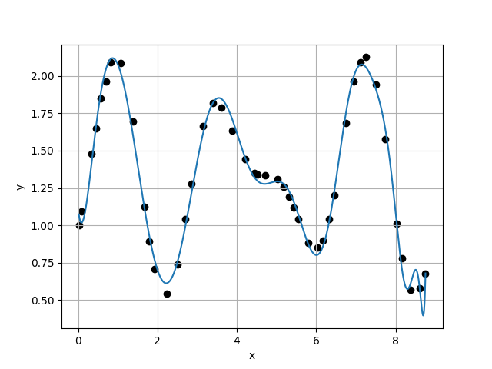
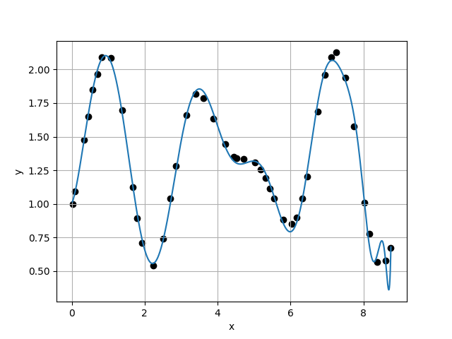
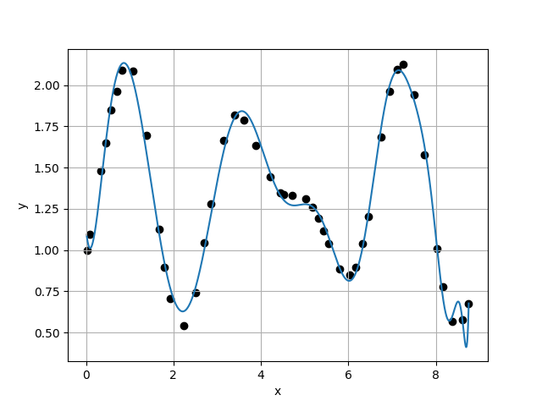
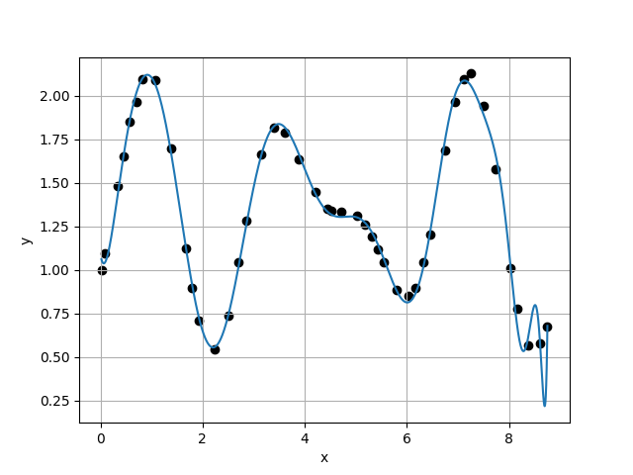








Case 33 :
Case 34 :
f(x) = 1.1150E+00 - 2.4261E+00 * x + 1.7562E+01 * x^2 - 3.1199E+01 * x^3 + 2.8926E+01 * x^4 - 1.7237E+01 * x^5 + 6.7976E+00 * x^6 - 1.6745E+00 * x^7 + 2.2770E-01 * x^8 - 1.3076E-02 * x^9 + 6.3171E-04 * x^10 - 2.3359E-04 * x^11 + 1.6883E-05 * x^12 + 2.5103E-06 * x^13 - 3.0288E-07 * x^14 + 2.6992E-08 * x^15 - 1.4340E-09 * x^16 - 4.0691E-10 * x^17 - 2.3615E-11 * x^18 + 7.2606E-12 * x^19 + 1.2979E-13 * x^20 + 7.1111E-14 * x^21 - 8.2786E-15 * x^22 - 6.2746E-16 * x^23 + 6.4065E-17 * x^24 - 1.4001E-17 * x^25 + 1.1509E-18 * x^26 - 6.6065E-20 * x^27 + 1.5215E-20 * x^28 + 9.8744E-22 * x^29 - 1.3711E-22 * x^30 - 1.8738E-23 * x^31 + 1.4823E-24 * x^32
f(x) = 1.0018E+00 + 5.9743E-01 * x + 4.3179E+00 * x^2 - 8.1364E+00 * x^3 + 9.2735E+00 * x^4 - 8.8575E+00 * x^5 + 5.5480E+00 * x^6 - 2.0212E+00 * x^7 + 4.0777E-01 * x^8 - 4.1258E-02 * x^9 + 2.2029E-03 * x^10 - 3.7136E-04 * x^11 + 5.0689E-05 * x^12 + 3.9898E-06 * x^13 - 7.8103E-07 * x^14 - 7.8128E-08 * x^15 + 9.4272E-09 * x^16 + 8.7514E-10 * x^17 - 4.4065E-11 * x^18 + 3.6843E-12 * x^19 - 2.5128E-12 * x^20 - 1.0013E-13 * x^21 + 5.1885E-14 * x^22 + 8.4173E-16 * x^23 - 4.4949E-16 * x^24 + 5.2904E-18 * x^25 - 5.8806E-19 * x^26 + 4.2728E-20 * x^27 - 1.4355E-20 * x^28 + 6.3772E-21 * x^29 - 2.8760E-22 * x^30 - 1.8565E-23 * x^31 - 5.8031E-25 * x^32 + 1.2047E-25 * x^33
$σ_{k}=$9.4764E-02
$σ_{k}=$7.3789E-02
$\frac{σ_{k}}{σ_{k+1}}=$1.2843E+00
$\frac{σ_{k}}{σ_{k+1}}=$6.8298E-01
Case 35 :
f(x) = 1.1289E+00 - 2.6808E+00 * x + 1.7870E+01 * x^2 - 2.9664E+01 * x^3 + 2.4668E+01 * x^4 - 1.2655E+01 * x^5 + 4.1313E+00 * x^6 - 7.5891E-01 * x^7 + 4.0411E-02 * x^8 + 8.7694E-03 * x^9 - 8.4147E-04 * x^10 - 9.8810E-05 * x^11 - 1.5852E-06 * x^12 + 2.5222E-06 * x^13 - 3.7511E-08 * x^14 + 1.0472E-08 * x^15 - 2.3075E-09 * x^16 - 2.7903E-10 * x^17 - 1.5519E-11 * x^18 + 3.6992E-12 * x^19 + 3.9737E-13 * x^20 + 4.7933E-14 * x^21 - 1.2801E-15 * x^22 - 1.3045E-15 * x^23 + 3.0196E-17 * x^24 - 3.7666E-18 * x^25 + 3.8688E-19 * x^26 + 9.7547E-20 * x^27 - 8.3495E-21 * x^28 + 8.4201E-22 * x^29 - 6.8793E-23 * x^30 + 2.2952E-24 * x^31 + 1.8017E-25 * x^32 - 1.1140E-25 * x^33 + 7.4636E-27 * x^34
Case 36 :
f(x) = 1.0880E+00 - 1.6711E+00 * x + 1.5691E+01 * x^2 - 3.3990E+01 * x^3 + 4.3027E+01 * x^4 - 3.6797E+01 * x^5 + 2.0858E+01 * x^6 - 7.6419E+00 * x^7 + 1.7696E+00 * x^8 - 2.4670E-01 * x^9 + 1.8231E-02 * x^10 - 4.5647E-04 * x^11 - 1.0375E-05 * x^12 + 1.1818E-06 * x^13 - 8.5945E-08 * x^14 + 5.2644E-09 * x^15 - 9.3471E-09 * x^16 + 3.7129E-10 * x^17 + 1.1614E-10 * x^18 + 2.0374E-11 * x^19 - 2.0673E-12 * x^20 - 2.1859E-13 * x^21 - 3.4259E-14 * x^22 + 2.7188E-15 * x^23 + 6.6643E-16 * x^24 - 4.6442E-17 * x^25 + 1.4144E-17 * x^26 - 1.3721E-18 * x^27 - 1.6914E-19 * x^28 + 5.9911E-21 * x^29 + 2.2320E-21 * x^30 - 8.0209E-23 * x^31 + 1.4869E-25 * x^32 - 2.0208E-25 * x^33 - 7.1226E-26 * x^34 + 5.4430E-27 * x^35
$σ_{k}=$1.0804E-01
$σ_{k}=$8.2947E-02
$\frac{σ_{k}}{σ_{k+1}}=$1.3025E+00
$\frac{σ_{k}}{σ_{k+1}}=$6.4069E-01

Slide 14
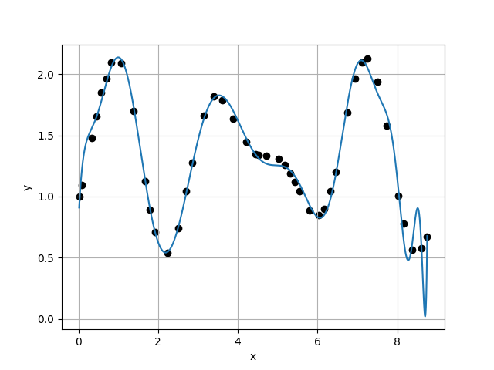
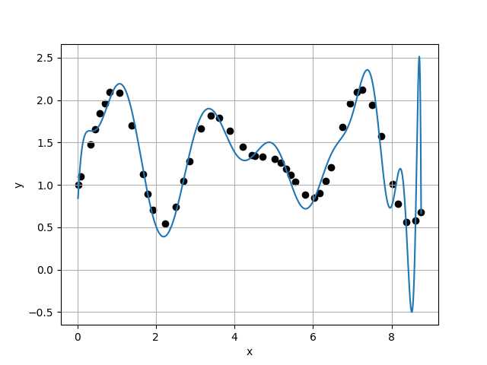
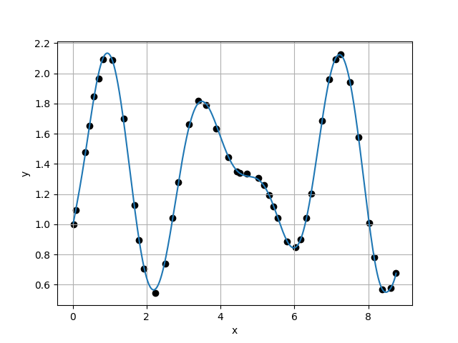
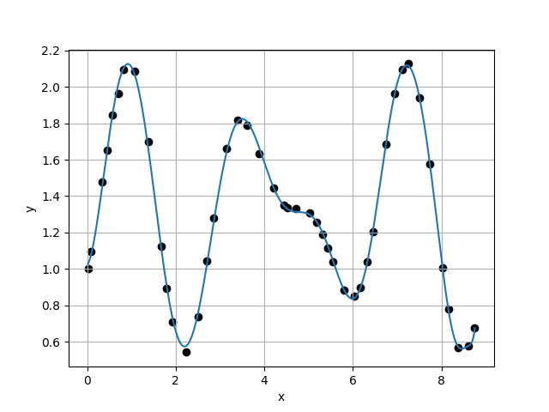








Case 37 :
Case 38 :
f(x) = 7.8155E-01 + 6.9313E+00 * x - 2.7614E+01 * x^2 + 5.9551E+01 * x^3 - 6.6867E+01 * x^4 + 4.1305E+01 * x^5 - 1.4420E+01 * x^6 + 2.6126E+00 * x^7 - 1.0576E-01 * x^8 - 4.5384E-02 * x^9 + 6.9607E-03 * x^10 - 3.7898E-05 * x^11 - 1.4790E-05 * x^12 - 1.2580E-05 * x^13 + 2.1683E-06 * x^14 - 9.0685E-08 * x^15 - 1.0383E-08 * x^16 + 2.0053E-09 * x^17 - 1.9392E-10 * x^18 + 1.9824E-11 * x^19 - 8.2295E-13 * x^20 + 3.7054E-15 * x^21 - 4.6301E-14 * x^22 + 3.8636E-15 * x^23 + 1.8921E-16 * x^24 + 3.6509E-17 * x^25 - 5.3343E-18 * x^26 + 4.0796E-19 * x^27 - 8.3062E-20 * x^28 - 2.2851E-21 * x^29 + 6.4259E-22 * x^30 - 5.3411E-23 * x^31 + 1.4956E-23 * x^32 - 1.0103E-25 * x^33 - 9.6169E-26 * x^34 - 4.7735E-27 * x^35 + 6.1073E-28 * x^36
f(x) = 6.4564E-01 + 1.0713E+01 * x - 4.4221E+01 * x^2 + 8.8224E+01 * x^3 - 9.1732E+01 * x^4 + 5.3955E+01 * x^5 - 1.9105E+01 * x^6 + 4.2648E+00 * x^7 - 6.3558E-01 * x^8 + 6.9513E-02 * x^9 - 5.9315E-03 * x^10 + 3.8182E-04 * x^11 - 2.5704E-05 * x^12 - 1.0513E-07 * x^13 + 5.9766E-07 * x^14 + 8.3525E-09 * x^15 - 1.9097E-08 * x^16 + 2.2641E-09 * x^17 - 8.0852E-11 * x^18 - 1.3391E-11 * x^19 + 3.4085E-13 * x^20 - 1.4006E-13 * x^21 + 8.3393E-14 * x^22 - 1.7484E-15 * x^23 - 5.0681E-16 * x^24 + 2.5118E-17 * x^25 - 7.0679E-18 * x^26 - 1.3170E-18 * x^27 + 1.4271E-19 * x^28 + 9.8764E-21 * x^29 + 1.4249E-21 * x^30 + 4.0120E-23 * x^31 - 1.7920E-23 * x^32 - 2.3205E-24 * x^33 - 2.6427E-25 * x^34 + 3.9485E-26 * x^35 + 3.5574E-27 * x^36 - 3.1432E-28 * x^37
$σ_{k}=$1.2946E-01
$σ_{k}=$3.4293E-01
$\frac{σ_{k}}{σ_{k+1}}=$3.7752E-01
$\frac{σ_{k}}{σ_{k+1}}=$1.0568E+01
Case 39 :
Case 40 :
f(x) = 9.8283E-01 + 1.3903E+00 * x - 1.1633E+00 * x^2 + 6.4816E+00 * x^3 - 1.0349E+01 * x^4 + 6.2451E+00 * x^5 - 1.5746E+00 * x^6 + 9.4847E-02 * x^7 + 1.0941E-02 * x^8 + 6.3885E-03 * x^9 - 2.3599E-03 * x^10 + 1.9007E-04 * x^11 - 2.9508E-06 * x^12 + 2.8688E-06 * x^13 - 4.2368E-07 * x^14 + 6.4815E-09 * x^15 - 1.7260E-09 * x^16 + 2.3934E-10 * x^17 + 2.1740E-11 * x^18 - 2.1495E-12 * x^19 + 3.6554E-13 * x^20 - 5.4080E-15 * x^21 - 6.6295E-15 * x^22 - 4.2881E-16 * x^23 + 2.6865E-17 * x^24 + 1.0049E-17 * x^25 + 4.2485E-19 * x^26 + 6.4083E-21 * x^27 - 2.1099E-20 * x^28 + 7.4019E-22 * x^29 - 6.9013E-23 * x^30 + 1.7572E-23 * x^31 + 1.3093E-24 * x^32 - 2.9846E-25 * x^33 + 5.3821E-27 * x^34 - 4.1577E-28 * x^35 + 2.0690E-28 * x^36 - 1.4521E-29 * x^37 + 2.6073E-31 * x^38
f(x) = 1.0203E+00 + 2.8974E-01 * x + 4.4080E+00 * x^2 - 5.1497E+00 * x^3 + 2.2843E+00 * x^4 - 1.6475E+00 * x^5 + 1.3628E+00 * x^6 - 5.4622E-01 * x^7 + 8.9768E-02 * x^8 - 1.3853E-03 * x^9 - 5.4740E-04 * x^10 - 1.5174E-04 * x^11 + 1.6786E-05 * x^12 + 3.3136E-06 * x^13 - 1.4050E-07 * x^14 - 4.8510E-08 * x^15 + 5.2152E-10 * x^16 - 1.3732E-10 * x^17 + 4.9782E-11 * x^18 + 4.7184E-12 * x^19 + 1.6039E-13 * x^20 - 4.3100E-14 * x^21 - 1.3465E-14 * x^22 - 6.6716E-16 * x^23 + 2.0000E-16 * x^24 + 9.9297E-18 * x^25 - 4.8023E-20 * x^26 - 2.0435E-19 * x^27 + 9.1803E-23 * x^28 - 2.7675E-22 * x^29 + 2.7466E-22 * x^30 - 1.1759E-23 * x^31 + 1.2585E-24 * x^32 - 6.0760E-25 * x^33 + 4.5197E-26 * x^34 + 6.2002E-28 * x^35 + 2.1840E-29 * x^36 - 4.9269E-30 * x^37 - 1.4794E-30 * x^38 + 9.2645E-32 * x^39
$σ_{k}=$3.2449E-02
$σ_{k}=$5.1073E-02
$\frac{σ_{k}}{σ_{k+1}}=$6.3533E-01
$\frac{σ_{k}}{σ_{k+1}}=$9.4716E-01

Slide 15
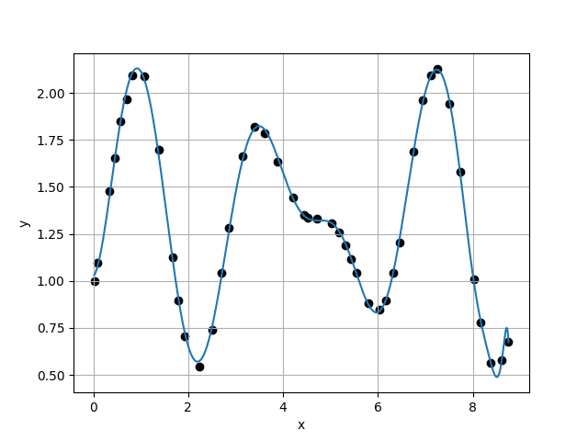
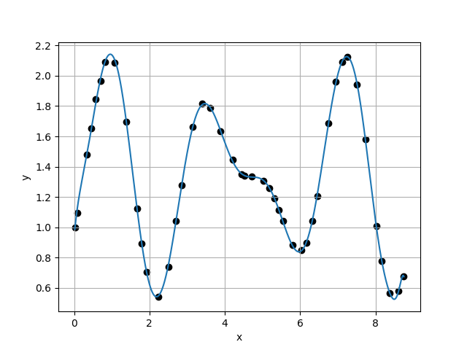
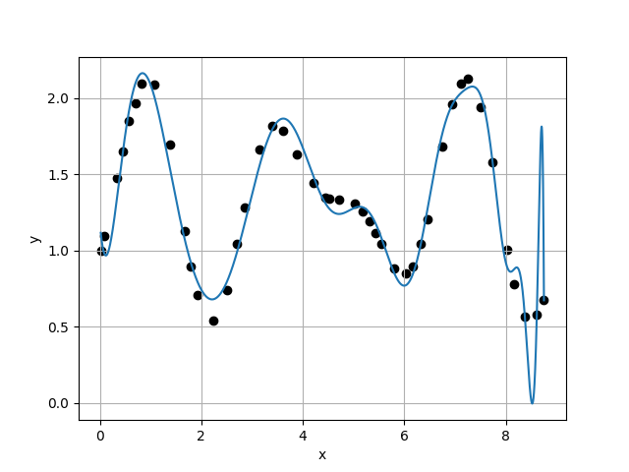
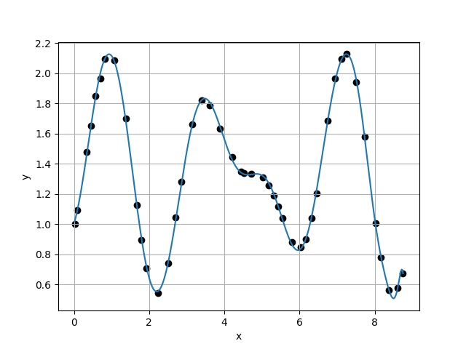






Case 41 :
Case 42 :
f(x) = 1.0249E+00 + 2.1445E-01 * x + 4.5613E+00 * x^2 - 5.1253E+00 * x^3 + 1.9864E+00 * x^4 - 1.3184E+00 * x^5 + 1.1810E+00 * x^6 - 4.8615E-01 * x^7 + 7.7306E-02 * x^8 + 1.0903E-04 * x^9 - 4.7282E-04 * x^10 - 2.7207E-04 * x^11 + 5.4393E-05 * x^12 - 1.6407E-06 * x^13 - 1.2694E-07 * x^14 + 4.1298E-09 * x^15 - 1.6152E-09 * x^16 - 7.3512E-11 * x^17 + 1.0657E-11 * x^18 + 2.0780E-12 * x^19 + 4.4051E-13 * x^20 - 5.3985E-14 * x^21 + 2.6131E-15 * x^22 + 2.1449E-16 * x^23 - 1.3057E-16 * x^24 - 3.0694E-18 * x^25 + 5.2980E-19 * x^26 + 1.1599E-19 * x^27 + 1.2184E-20 * x^28 - 1.5046E-21 * x^29 - 2.6165E-22 * x^30 + 5.7248E-23 * x^31 - 4.1891E-24 * x^32 - 6.9021E-26 * x^33 + 4.7443E-26 * x^34 - 8.5961E-27 * x^35 + 4.7823E-28 * x^36 + 2.7315E-29 * x^37 + 6.6620E-31 * x^38 - 4.7103E-31 * x^39 + 1.8893E-32 * x^40
f(x) = 9.3634E-01 + 2.7379E+00 * x - 7.7185E+00 * x^2 + 1.9542E+01 * x^3 - 2.3862E+01 * x^4 + 1.4297E+01 * x^5 - 4.4234E+00 * x^6 + 6.5978E-01 * x^7 - 3.0069E-02 * x^8 - 2.6079E-04 * x^9 - 5.8379E-04 * x^10 + 4.8493E-05 * x^11 + 3.5811E-06 * x^12 + 9.9878E-07 * x^13 - 6.9396E-08 * x^14 - 2.6022E-08 * x^15 + 1.2430E-09 * x^16 + 2.4504E-11 * x^17 + 3.7801E-12 * x^18 + 2.1140E-12 * x^19 + 7.0036E-14 * x^20 - 3.4374E-14 * x^21 + 2.6726E-15 * x^22 - 6.0649E-16 * x^23 + 5.2213E-17 * x^24 - 2.1310E-18 * x^25 - 8.5129E-19 * x^26 + 1.3883E-19 * x^27 - 2.6414E-21 * x^28 + 5.8407E-22 * x^29 + 7.1923E-24 * x^30 - 1.3795E-23 * x^31 + 3.0054E-26 * x^32 + 7.8767E-26 * x^33 + 7.1766E-27 * x^34 - 2.5583E-27 * x^35 - 7.5589E-29 * x^36 + 2.2149E-29 * x^37 + 4.0908E-30 * x^38 - 3.0846E-31 * x^39 - 3.0021E-32 * x^40 + 2.1188E-33 * x^41
$σ_{k}=$5.3922E-02
$σ_{k}=$3.4832E-02
$\frac{σ_{k}}{σ_{k+1}}=$1.5481E+00
$\frac{σ_{k}}{σ_{k+1}}=$9.5491E-02
Case 43 :
f(x) = 1.1904E+00 - 4.1297E+00 * x + 2.2690E+01 * x^2 - 3.3746E+01 * x^3 + 2.1527E+01 * x^4 - 4.8861E+00 * x^5 - 1.6159E+00 * x^6 + 1.4036E+00 * x^7 - 3.8929E-01 * x^8 + 4.6298E-02 * x^9 - 1.3536E-03 * x^10 + 1.5004E-04 * x^11 - 7.3624E-05 * x^12 + 1.3330E-06 * x^13 + 1.1132E-06 * x^14 - 3.5612E-08 * x^15 - 6.1782E-09 * x^16 + 4.8725E-10 * x^17 - 1.1283E-11 * x^18 - 5.9512E-12 * x^19 - 1.2240E-12 * x^20 + 1.3811E-13 * x^21 + 8.1359E-15 * x^22 - 3.9396E-16 * x^23 + 3.0976E-16 * x^24 + 8.0172E-18 * x^25 - 1.5955E-18 * x^26 - 6.4323E-19 * x^27 - 4.2284E-20 * x^28 + 1.3947E-21 * x^29 + 4.3362E-22 * x^30 + 5.0434E-23 * x^31 + 9.9883E-24 * x^32 - 6.4015E-25 * x^33 - 3.8379E-26 * x^34 + 5.5776E-27 * x^35 - 9.1462E-28 * x^36 - 1.5709E-28 * x^37 + 6.0630E-30 * x^38 + 6.1531E-31 * x^39 + 9.1490E-32 * x^40 + 8.5038E-33 * x^41 - 1.2899E-33 * x^42
Case 44 :
f(x) = 1.0025E+00 + 8.0662E-01 * x + 2.1051E+00 * x^2 - 1.1534E+00 * x^3 - 1.1536E+00 * x^4 + 2.7035E-02 * x^5 + 8.1176E-01 * x^6 - 3.7589E-01 * x^7 + 3.5722E-02 * x^8 + 1.0810E-02 * x^9 - 1.8113E-03 * x^10 - 1.9503E-04 * x^11 + 3.5992E-05 * x^12 + 2.8264E-06 * x^13 - 2.5909E-07 * x^14 - 4.5244E-08 * x^15 + 3.5906E-10 * x^16 + 5.9811E-11 * x^17 + 3.6551E-11 * x^18 + 4.6298E-12 * x^19 - 5.0649E-13 * x^20 + 8.4206E-15 * x^21 - 4.2376E-15 * x^22 + 6.3999E-16 * x^23 - 1.2676E-16 * x^24 + 4.4708E-18 * x^25 + 4.6126E-19 * x^26 + 2.9748E-20 * x^27 - 5.1038E-21 * x^28 - 1.3848E-22 * x^29 + 9.4719E-23 * x^30 + 5.2496E-25 * x^31 + 1.5643E-24 * x^32 - 2.5611E-25 * x^33 + 2.0777E-27 * x^34 - 1.7631E-27 * x^35 - 1.8535E-28 * x^36 + 1.6114E-29 * x^37 + 5.2222E-30 * x^38 - 1.3416E-31 * x^39 + 2.0964E-32 * x^40 - 3.7660E-33 * x^41 - 3.5030E-34 * x^42 + 3.4112E-35 * x^43
$σ_{k}=$3.6477E-01
$\frac{σ_{k}}{σ_{k+1}}=$4.6577E+00

Slide 16
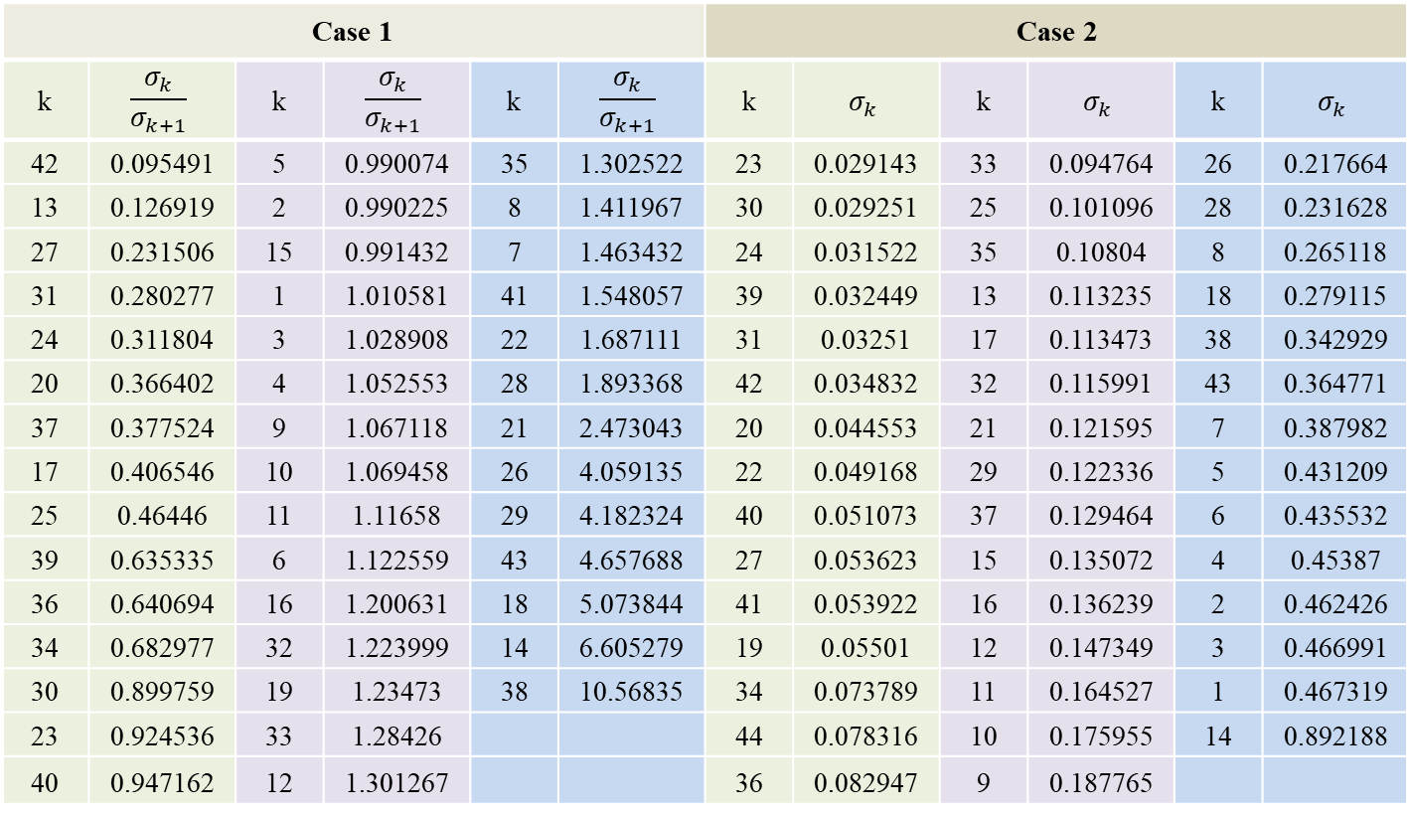
Case 1 |  |  |  |  |  | Case 2
k | $$\frac{σ_{k}}{σ_{k+1}}$$ | k | $$\frac{σ_{k}}{σ_{k+1}}$$ | k | $$\frac{σ_{k}}{σ_{k+1}}$$ | k | $$σ_{k}$$ | k | $$σ_{k}$$ | k | $$σ_{k}$$
42 | 0.095491 | 5 | 0.990074 | 35 | 1.302522 | 23 | 0.029143 | 33 | 0.094764 | 26 | 0.217664
13 | 0.126919 | 2 | 0.990225 | 8 | 1.411967 | 30 | 0.029251 | 25 | 0.101096 | 28 | 0.231628
27 | 0.231506 | 15 | 0.991432 | 7 | 1.463432 | 24 | 0.031522 | 35 | 0.10804 | 8 | 0.265118
31 | 0.280277 | 1 | 1.010581 | 41 | 1.548057 | 39 | 0.032449 | 13 | 0.113235 | 18 | 0.279115
24 | 0.311804 | 3 | 1.028908 | 22 | 1.687111 | 31 | 0.03251 | 17 | 0.113473 | 38 | 0.342929
20 | 0.366402 | 4 | 1.052553 | 28 | 1.893368 | 42 | 0.034832 | 32 | 0.115991 | 43 | 0.364771
37 | 0.377524 | 9 | 1.067118 | 21 | 2.473043 | 20 | 0.044553 | 21 | 0.121595 | 7 | 0.387982
17 | 0.406546 | 10 | 1.069458 | 26 | 4.059135 | 22 | 0.049168 | 29 | 0.122336 | 5 | 0.431209
25 | 0.46446 | 11 | 1.11658 | 29 | 4.182324 | 40 | 0.051073 | 37 | 0.129464 | 6 | 0.435532
39 | 0.635335 | 6 | 1.122559 | 43 | 4.657688 | 27 | 0.053623 | 15 | 0.135072 | 4 | 0.45387
36 | 0.640694 | 16 | 1.200631 | 18 | 5.073844 | 41 | 0.053922 | 16 | 0.136239 | 2 | 0.462426
34 | 0.682977 | 32 | 1.223999 | 14 | 6.605279 | 19 | 0.05501 | 12 | 0.147349 | 3 | 0.466991
30 | 0.899759 | 19 | 1.23473 | 38 | 10.56835 | 34 | 0.073789 | 11 | 0.164527 | 1 | 0.467319
23 | 0.924536 | 33 | 1.28426 |  |  | 44 | 0.078316 | 10 | 0.175955 | 14 | 0.892188
40 | 0.947162 | 12 | 1.301267 |  |  | 36 | 0.082947 | 9 | 0.187765

Slide 17



In Case 1, The best choice is $P_{42}\left(x\right)$
In Case 2, The best choice is $P_{23}\left(x\right)$
f(x) = 9.3634E-01 + 2.7379E+00 * x - 7.7185E+00 * x^2 + 1.9542E+01 * x^3 - 2.3862E+01 * x^4 + 1.4297E+01 * x^5 - 4.4234E+00 * x^6 + 6.5978E-01 * x^7 - 3.0069E-02 * x^8 - 2.6079E-04 * x^9 - 5.8379E-04 * x^10 + 4.8493E-05 * x^11 + 3.5811E-06 * x^12 + 9.9878E-07 * x^13 - 6.9396E-08 * x^14 - 2.6022E-08 * x^15 + 1.2430E-09 * x^16 + 2.4504E-11 * x^17 + 3.7801E-12 * x^18 + 2.1140E-12 * x^19 + 7.0036E-14 * x^20 - 3.4374E-14 * x^21 + 2.6726E-15 * x^22 - 6.0649E-16 * x^23 + 5.2213E-17 * x^24 - 2.1310E-18 * x^25 - 8.5129E-19 * x^26 + 1.3883E-19 * x^27 - 2.6414E-21 * x^28 + 5.8407E-22 * x^29 + 7.1923E-24 * x^30 - 1.3795E-23 * x^31 + 3.0054E-26 * x^32 + 7.8767E-26 * x^33 + 7.1766E-27 * x^34 - 2.5583E-27 * x^35 - 7.5589E-29 * x^36 + 2.2149E-29 * x^37 + 4.0908E-30 * x^38 - 3.0846E-31 * x^39 - 3.0021E-32 * x^40 + 2.1188E-33 * x^41
f(x) = 8.9555E-01 + 3.7718E+00 * x - 1.2220E+01 * x^2 + 2.7663E+01 * x^3 - 3.1421E+01 * x^4 + 1.8109E+01 * x^5 - 5.3070E+00 * x^6 + 6.0390E-01 * x^7 + 5.9007E-02 * x^8 - 2.1808E-02 * x^9 + 1.1722E-03 * x^10 + 1.3100E-04 * x^11 - 7.6800E-06 * x^12 - 8.5752E-07 * x^13 + 1.0231E-07 * x^14 - 1.6236E-08 * x^15 - 1.1984E-09 * x^16 + 3.6072E-10 * x^17 + 4.1009E-11 * x^18 - 6.4732E-12 * x^19 - 5.6029E-13 * x^20 + 1.0455E-13 * x^21 - 3.7802E-15 * x^22

Slide 18
自訂

Slide 19
 | X | Y |  | X | Y |  | X | Y
1 | 0 | 1 | 16 | 3.25 | 1.7564 | 31 | 6.19 | 0.9213
2 | 0.2 | 1.2482 | 17 | 3.39 | 1.8162 | 32 | 6.42 | 1.1665
3 | 0.48 | 1.7019 | 18 | 3.71 | 1.7406 | 33 | 6.7 | 1.5988
4 | 0.61 | 1.8899 | 19 | 4.02 | 1.5357 | 34 | 6.91 | 1.9059
5 | 0.8 | 2.08 | 20 | 4.13 | 1.4631 | 35 | 7.17 | 2.1186
6 | 1.01 | 2.1157 | 21 | 4.24 | 1.4105 | 36 | 7.34 | 2.0953
7 | 1.12 | 2.0514 | 22 | 4.33 | 1.3752 | 37 | 7.49 | 1.9652
8 | 1.27 | 1.8839 | 23 | 4.64 | 1.3337 | 38 | 7.6 | 1.814
9 | 1.48 | 1.5201 | 24 | 4.87 | 1.33 | 39 | 7.92 | 1.1951
10 | 1.72 | 1.0361 | 25 | 5.06 | 1.3022 | 40 | 8.15 | 0.7906
11 | 1.97 | 0.663 | 26 | 5.17 | 1.2625 | 41 | 8.41 | 0.5518
12 | 2.25 | 0.5458 | 27 | 5.44 | 1.1111 | 42 | 8.61 | 0.5768
13 | 2.52 | 0.7697 | 28 | 5.53 | 1.0496 | 43 | 8.73 | 0.6775
14 | 2.78 | 1.1515 | 29 | 5.77 | 0.893 | 44 | 9 | 1.0472
15 | 2.94 | 1.4096 | 30 | 5.88 | 0.8547 | 45 | 9.2 | 1.3796

Slide 20
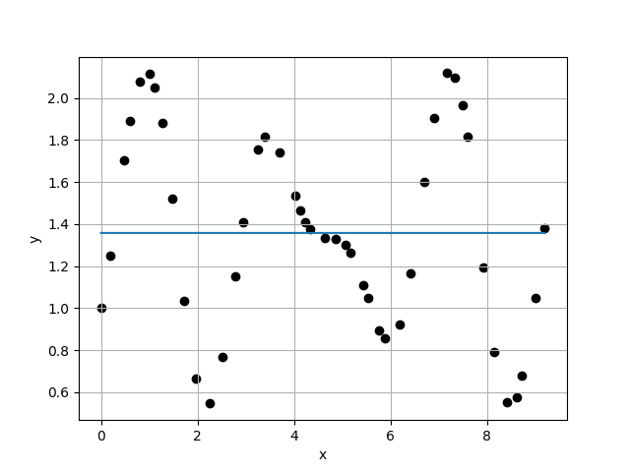
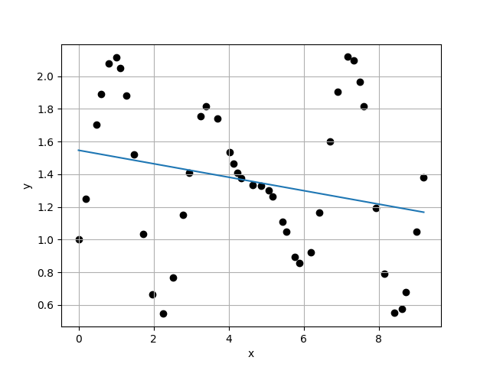
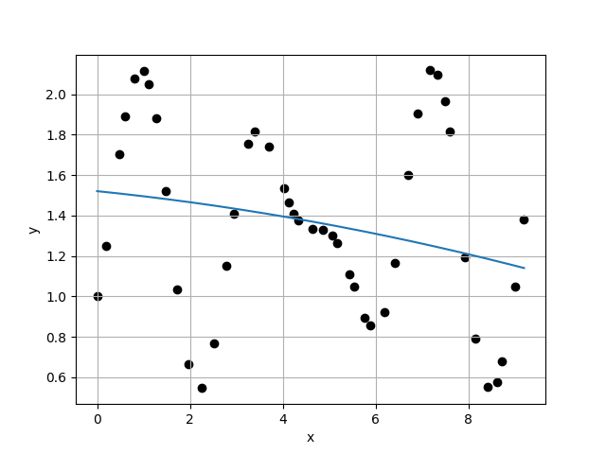
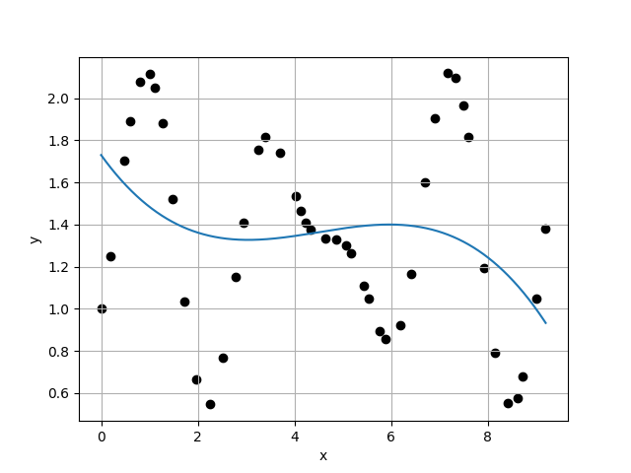
Case 1 :
Case 2 :
f(x) = 1.3579E+00
f(x) = 1.5470E+00 + -4.1230E-02 * x
4.6980E-01
4.6114E-01
1.0188E+00
9.8871E-01
Case 3 :
f(x) = 1.5209E+00 + -2.3492E-02 * x + -1.9422E-03 * x^2
Case 4 :
f(x) = 1.7304E+00 + -3.1918E-01 * x + 7.9197E-02 * x^2 + -5.8617E-03 * x^3
4.6641E-01
4.6262E-01
1.0082E+00
1.0111E+00

Slide 21
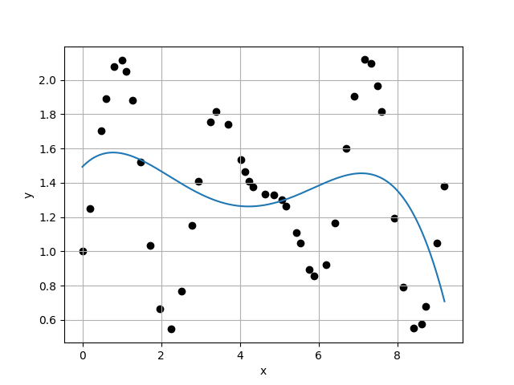



Case 5 :
Case 6 :
f(x) = 1.4933E+00 + 2.3636E-01 * x + -1.9591E-01 * x^2 + 4.0735E-02 * x^3 + -2.5263E-03 * x^4
f(x) = 1.2900E+00 + 9.9566E-01 * x + -8.0420E-01 * x^2 + 2.2094E-01 * x^3 + -2.4759E-02 * x^4 + 9.6882E-04 * x^5
4.5756E-01
4.5439E-01
1.0070E+00
9.8904E-01
Case 7 :
f(x) = 1.2327E+00 + 1.3293E+00 * x + -1.1990E+00 * x^2 + 3.9899E-01 * x^3 + -6.1697E-02 * x^4 + 4.5331E-03 * x^5 + -1.2961E-04 * x^6
Case 8 :
f(x) = 5.5533E-01 + 7.2956E+00 * x + -1.0875E+01 * x^2 + 6.4761E+00 * x^3 + -1.9091E+00 * x^4 + 2.9559E-01 * x^5 + -2.3004E-02 * x^6 + 7.0897E-04 * x^7
4.5943E-01
2.7578E-01
1.6659E+00
1.0633E+00

Slide 22




Case 9 :
Case 10 :
f(x) = 7.2528E-01 + 5.0926E+00 * x + -6.1768E+00 * x^2 + 2.5506E+00 * x^3 + -2.7270E-01 * x^4 + -7.8384E-02 * x^5 + 2.4625E-02 * x^6 + -2.4617E-03 * x^7 + 8.5967E-05 * x^8
f(x) = 9.7606E-01 + 3.6274E-01 * x + 6.7892E+00 * x^2 + -1.1446E+01 * x^3 + 7.4059E+00 * x^4 + -2.4656E+00 * x^5 + 4.6303E-01 * x^6 + -4.9552E-02 * x^7 + 2.8199E-03 * x^8 + -6.6236E-05 * x^9
2.5935E-01
1.8644E-01
1.3910E+00
9.8752E-01
Case 11 :
f(x) = 9.8979E-01 + -1.0199E-02 * x + 8.0635E+00 * x^2 + -1.3155E+01 * x^3 + 8.5837E+00 * x^4 + -2.9355E+00 * x^5 + 5.7780E-01 * x^6 + -6.6974E-02 * x^7 + 4.4228E-03 * x^8 + -1.4806E-04 * x^9 + 1.7782E-06 * x^10
Case 12 :
f(x) = 1.0952E+00 + -4.0845E+00 * x + 2.5052E+01 * x^2 + -4.0891E+01 * x^3 + 3.2076E+01 * x^4 + -1.4645E+01 * x^5 + 4.2387E+00 * x^6 + -8.0522E-01 * x^7 + 1.0036E-01 * x^8 + -7.9061E-03 * x^9 + 3.5690E-04 * x^10 + -7.0279E-06 * x^11
1.8880E-01
1.5609E-01
1.2096E+00
1.0358E+00

Slide 23




Case 13 :
Case 14 :
f(x) = 1.0524E+00 + -1.2382E+00 * x + 1.0009E+01 * x^2 + -1.0432E+01 * x^3 + 1.8984E-01 * x^4 + 5.0878E+00 * x^5 + -3.5135E+00 * x^6 + 1.2015E+00 * x^7 + -2.4642E-01 * x^8 + 3.1692E-02 * x^9 + -2.5116E-03 * x^10 + 1.1237E-04 * x^11 + -2.1747E-06 * x^12
f(x) = 1.0742E+00 + -2.8799E+00 * x + 1.9069E+01 * x^2 + -2.9520E+01 * x^3 + 2.1025E+01 * x^4 + -8.4258E+00 * x^5 + 2.0976E+00 * x^6 + -3.5310E-01 * x^7 + 4.6623E-02 * x^8 + -5.9176E-03 * x^9 + 7.1136E-04 * x^10 + -6.3178E-05 * x^11 + 3.2816E-06 * x^12 + -7.2886E-08 * x^13
1.5069E-01
1.5755E-01
9.5647E-01
1.0491E+00
Case 15 :
f(x) = 1.1039E+00 + -3.9565E+00 * x + 2.3244E+01 * x^2 + -3.5476E+01 * x^3 + 2.4846E+01 * x^4 + -9.3250E+00 * x^5 + 1.8668E+00 * x^6 + -1.3952E-01 * x^7 + -1.5719E-02 * x^8 + 3.2288E-03 * x^9 + 1.6676E-04 * x^10 + -9.3738E-05 * x^11 + 1.0622E-05 * x^12 + -5.4013E-07 * x^13 + 1.0745E-08 * x^14
Case 16 :
f(x) = 1.2824E+00 + -9.5659E+00 * x + 4.2090E+01 * x^2 + -5.3273E+01 * x^3 + 1.9255E+01 * x^4 + 1.3134E+01 * x^5 + -1.7083E+01 * x^6 + 8.4856E+00 * x^7 + -2.4457E+00 * x^8 + 4.3876E-01 * x^9 + -4.7101E-02 * x^10 + 2.2634E-03 * x^11 + 9.4540E-05 * x^12 + -2.0474E-05 * x^13 + 1.1518E-06 * x^14 + -2.3738E-08 * x^15
1.5018E-01
2.9081E-01
5.1643E-01
3.3047E+00

Slide 24




Case 17 :
Case 18 :
f(x) = 1.0367E+00 + -3.7558E-01 * x + 5.6212E+00 * x^2 + -2.1009E+00 * x^3 + -7.2818E+00 * x^4 + 8.1974E+00 * x^5 + -3.6753E+00 * x^6 + 7.8440E-01 * x^7 + -4.7804E-02 * x^8 + -1.2697E-02 * x^9 + 2.7211E-03 * x^10 + -1.3190E-04 * x^11 + -1.1511E-05 * x^12 + 8.6173E-07 * x^13 + 1.0356E-07 * x^14 + -1.2685E-08 * x^15 + 3.7655E-10 * x^16
f(x) = 9.8277E-01 + 9.0061E-01 * x + 3.9564E+00 * x^2 + -8.6614E+00 * x^3 + 1.0334E+01 * x^4 + -9.4644E+00 * x^5 + 5.7039E+00 * x^6 + -2.0471E+00 * x^7 + 4.0435E-01 * x^8 + -3.1568E-02 * x^9 + -2.4621E-03 * x^10 + 5.1210E-04 * x^11 + 2.7634E-05 * x^12 + -1.0347E-05 * x^13 + 4.1445E-07 * x^14 + 6.0251E-08 * x^15 + -6.3314E-09 * x^16 + 1.7623E-10 * x^17
8.8000E-02
1.7280E-01
5.0926E-01
1.7391E+00
Case 19 :
f(x) = 1.0355E+00 + -3.1975E-01 * x + 5.4596E+00 * x^2 + -2.0103E+00 * x^3 + -7.2822E+00 * x^4 + 8.3620E+00 * x^5 + -3.9782E+00 * x^6 + 1.0069E+00 * x^7 + -1.3568E-01 * x^8 + 7.2600E-03 * x^9 + 2.6790E-04 * x^10 + -2.6521E-05 * x^11 + -5.0856E-06 * x^12 + 1.0748E-06 * x^13 + -1.2505E-07 * x^14 + 6.3734E-09 * x^15 + 5.0104E-10 * x^16 + -7.7408E-11 * x^17 + 2.6274E-12 * x^18
Case 20 :
f(x) = 8.2853E-01 + 1.0223E+01 * x + -4.3781E+01 * x^2 + 8.3391E+01 * x^3 + -7.7201E+01 * x^4 + 3.4996E+01 * x^5 + -5.4393E+00 * x^6 + -1.6709E+00 * x^7 + 9.3202E-01 * x^8 + -1.6270E-01 * x^9 + 7.1773E-03 * x^10 + 1.0280E-03 * x^11 + -7.0090E-06 * x^12 + -2.7210E-05 * x^13 + 1.7253E-06 * x^14 + 1.8608E-07 * x^15 + -1.5196E-08 * x^16 + -1.4426E-09 * x^17 + 1.8511E-10 * x^18 + -5.4126E-12 * x^19
9.9359E-02
1.8274E-01
5.4373E-01
4.2623E-01

Slide 25




Case 21 :
Case 22 :
f(x) = 7.3097E-01 + 1.8282E+01 * x + -9.0844E+01 * x^2 + 1.8757E+02 * x^3 + -1.9506E+02 * x^4 + 1.1249E+02 * x^5 + -3.6953E+01 * x^6 + 6.4309E+00 * x^7 + -3.6174E-01 * x^8 + -4.6084E-02 * x^9 + 3.9522E-03 * x^10 + 4.6896E-04 * x^11 + 8.5930E-05 * x^12 + -3.1927E-05 * x^13 + 8.4877E-07 * x^14 + 3.7433E-07 * x^15 + -3.2802E-08 * x^16 + 3.5214E-10 * x^17 + -2.5953E-11 * x^18 + 8.9469E-12 * x^19 + -3.7575E-13 * x^20
f(x) = 1.0048E+00 + 1.9547E+00 * x + -7.3875E+00 * x^2 + 2.5673E+01 * x^3 + -3.7796E+01 * x^4 + 2.7822E+01 * x^5 + -1.1556E+01 * x^6 + 2.8189E+00 * x^7 + -3.8744E-01 * x^8 + 2.4216E-02 * x^9 + -2.4876E-04 * x^10 + 1.5779E-04 * x^11 + -5.0994E-05 * x^12 + 5.7878E-06 * x^13 + -4.3021E-07 * x^14 + 3.9683E-08 * x^15 + -4.3394E-09 * x^16 + 3.8014E-10 * x^17 + -1.6655E-11 * x^18 + -8.3845E-13 * x^19 + 1.3432E-13 * x^20 + -4.3853E-15 * x^21
4.2873E-01
5.4948E-02
7.8024E+00
1.2436E+00
Case 23 :
f(x) = 1.0005E+00 + 1.6896E+00 * x + -4.5596E+00 * x^2 + 1.6767E+01 * x^3 + -2.4583E+01 * x^4 + 1.6859E+01 * x^5 + -6.0525E+00 * x^6 + 1.0997E+00 * x^7 + -6.0022E-02 * x^8 + -1.0177E-02 * x^9 + 1.2053E-03 * x^10 + 9.8836E-05 * x^11 + -2.0159E-05 * x^12 + 1.3711E-06 * x^13 + -1.9752E-07 * x^14 + 1.5399E-08 * x^15 + 9.4486E-10 * x^16 + -1.2282E-10 * x^17 + 3.3507E-13 * x^18 + 6.0565E-13 * x^19 + -1.8073E-13 * x^20 + 2.0103E-14 * x^21 + -6.9463E-16 * x^22
Case 24 :
f(x) = 1.0188E+00 + 4.0391E-01 * x + 2.7161E+00 * x^2 + 9.9758E-01 * x^3 + -7.1876E+00 * x^4 + 5.9317E+00 * x^5 + -2.0094E+00 * x^6 + 2.6104E-01 * x^7 + 1.0923E-02 * x^8 + -4.8195E-03 * x^9 + -8.4288E-05 * x^10 + 5.9985E-05 * x^11 + 8.5306E-07 * x^12 + -1.0573E-07 * x^13 + -9.5036E-09 * x^14 + -1.2048E-08 * x^15 + -1.4730E-10 * x^16 + 3.2619E-10 * x^17 + -1.8768E-11 * x^18 + 3.1380E-13 * x^19 + -1.4269E-13 * x^20 + 8.0519E-17 * x^21 + 1.7816E-15 * x^22 + -8.4932E-17 * x^23
4.4184E-02
6.4189E-02
6.8834E-01
1.0730E+00

Slide 26




Case 25 :
Case 26 :
f(x) = 1.0051E+00 + 1.1227E+00 * x + -9.2243E-01 * x^2 + 8.2795E+00 * x^3 + -1.4852E+01 * x^4 + 1.0741E+01 * x^5 + -3.9288E+00 * x^6 + 7.6369E-01 * x^7 + -7.5945E-02 * x^8 + 4.7983E-03 * x^9 + -6.7081E-04 * x^10 + 6.0062E-05 * x^11 + 3.5547E-06 * x^12 + -8.5949E-08 * x^13 + -3.1872E-08 * x^14 + -1.6966E-08 * x^15 + 1.3040E-09 * x^16 + 1.4872E-10 * x^17 + -1.1521E-12 * x^18 + -4.6161E-14 * x^19 + -4.3379E-13 * x^20 + 4.4418E-14 * x^21 + -7.3112E-16 * x^22 + -4.2770E-17 * x^23 + 5.6385E-19 * x^24
f(x) = 1.0134E+00 + 9.2717E-01 * x + -4.0120E-01 * x^2 + 7.8862E+00 * x^3 + -1.4810E+01 * x^4 + 1.0706E+01 * x^5 + -3.7919E+00 * x^6 + 6.5952E-01 * x^7 + -4.0262E-02 * x^8 + -1.3425E-03 * x^9 + -2.0509E-04 * x^10 + 5.9841E-05 * x^11 + -9.7173E-07 * x^12 + 1.3257E-06 * x^13 + -2.1491E-07 * x^14 + -2.2167E-08 * x^15 + 3.3486E-09 * x^16 + 2.1400E-10 * x^17 + -1.2377E-11 * x^18 + -2.5744E-12 * x^19 + -6.1035E-14 * x^20 + 9.8828E-15 * x^21 + 2.7110E-15 * x^22 + -1.3192E-16 * x^23 + -1.2033E-17 * x^24 + 6.6459E-19 * x^25
5.9823E-02
4.6011E-02
1.3002E+00
3.7384E-01
Case 27 :
f(x) = 1.0074E+00 + 1.1987E+00 * x + -2.5211E+00 * x^2 + 1.5007E+01 * x^3 + -2.7090E+01 * x^4 + 2.2774E+01 * x^5 + -1.1016E+01 * x^6 + 3.3970E+00 * x^7 + -7.0740E-01 * x^8 + 1.0304E-01 * x^9 + -1.0402E-02 * x^10 + 5.1643E-04 * x^11 + 5.8510E-05 * x^12 + -1.4914E-05 * x^13 + 8.3930E-07 * x^14 + 3.5575E-08 * x^15 + 9.1261E-09 * x^16 + -2.8245E-09 * x^17 + 1.0348E-10 * x^18 + 1.4890E-11 * x^19 + -1.1937E-12 * x^20 + 9.5703E-14 * x^21 + 6.5371E-16 * x^22 + -3.8625E-15 * x^23 + 5.3530E-16 * x^24 + -2.7569E-17 * x^25 + 4.8811E-19 * x^26
Case 28 :
f(x) = 9.6216E-01 + 3.2577E+00 * x + -1.0784E+01 * x^2 + 2.5166E+01 * x^3 + -2.8476E+01 * x^4 + 1.5918E+01 * x^5 + -4.3638E+00 * x^6 + 4.1269E-01 * x^7 + 5.1447E-02 * x^8 + -9.3721E-03 * x^9 + -1.1948E-03 * x^10 + 2.2958E-04 * x^11 + 1.3633E-05 * x^12 + -3.2894E-06 * x^13 + 6.7939E-08 * x^14 + 4.5191E-09 * x^15 + -1.9130E-09 * x^16 + 1.8675E-10 * x^17 + 1.0682E-11 * x^18 + 3.8231E-12 * x^19 + -4.9514E-13 * x^20 + -3.2165E-14 * x^21 + -9.6013E-16 * x^22 + 4.1388E-16 * x^23 + 3.8124E-17 * x^24 + 1.8568E-19 * x^25 + -7.4214E-19 * x^26 + 3.5740E-20 * x^27
1.2308E-01
5.1889E-02
2.3720E+00
9.5039E-01

Slide 27




Case 29 :
Case 30 :
f(x) = 1.0221E+00 + 7.1689E-01 * x + 2.6065E-02 * x^2 + 8.2088E+00 * x^3 + -1.6261E+01 * x^4 + 1.2134E+01 * x^5 + -4.4123E+00 * x^6 + 7.5280E-01 * x^7 + -1.7981E-02 * x^8 + -1.2795E-02 * x^9 + 1.4196E-03 * x^10 + 2.5878E-05 * x^11 + -4.5739E-06 * x^12 + -4.8363E-07 * x^13 + -9.2717E-08 * x^14 + 1.0451E-08 * x^15 + 2.8127E-09 * x^16 + -2.6106E-10 * x^17 + -2.4096E-11 * x^18 + 1.3738E-12 * x^19 + 1.8819E-13 * x^20 + 1.8943E-14 * x^21 + -3.4286E-16 * x^22 + -7.4128E-16 * x^23 + 2.3165E-17 * x^24 + 4.9672E-18 * x^25 + 1.4263E-19 * x^26 + -6.1218E-20 * x^27 + 2.4116E-21 * x^28
f(x) = 7.3457E-01 + 4.2523E+01 * x + -2.8185E+02 * x^2 + 7.0288E+02 * x^3 + -8.6889E+02 * x^4 + 6.0174E+02 * x^5 + -2.4453E+02 * x^6 + 5.6901E+01 * x^7 + -6.3068E+00 * x^8 + -2.6112E-02 * x^9 + 5.8082E-02 * x^10 + 1.6733E-03 * x^11 + -8.5176E-04 * x^12 + 4.1605E-05 * x^13 + -1.3357E-05 * x^14 + 2.4928E-06 * x^15 + -7.7379E-08 * x^16 + 2.0468E-09 * x^17 + -1.2067E-09 * x^18 + 1.2935E-11 * x^19 + -8.6208E-12 * x^20 + 7.3034E-13 * x^21 + 3.1762E-13 * x^22 + -1.3431E-14 * x^23 + -2.5183E-15 * x^24 + 2.2184E-17 * x^25 + 7.7023E-18 * x^26 + 9.2216E-19 * x^27 + -5.8219E-20 * x^28 + -5.8057E-22 * x^29
5.4597E-02
1.8549E+00
2.9434E-02
1.7327E+00
Case 31 :
f(x) = 1.6831E+00 + -2.4295E+01 * x + 1.0134E+02 * x^2 + -1.4845E+02 * x^3 + 1.0655E+02 * x^4 + -4.5843E+01 * x^5 + 1.5844E+01 * x^6 + -5.5151E+00 * x^7 + 1.4958E+00 * x^8 + -1.9076E-01 * x^9 + -1.0629E-02 * x^10 + 4.8708E-03 * x^11 + 4.7392E-05 * x^12 + -9.5937E-05 * x^13 + 2.2442E-06 * x^14 + 8.3083E-07 * x^15 + 1.4069E-08 * x^16 + -4.3417E-09 * x^17 + -4.9427E-10 * x^18 + -7.5989E-11 * x^19 + 1.0390E-11 * x^20 + 1.2214E-12 * x^21 + 1.3685E-14 * x^22 + -2.4756E-14 * x^23 + -9.4505E-16 * x^24 + 3.6525E-16 * x^25 + 7.7911E-19 * x^26 + -2.6200E-18 * x^27 + 5.1728E-21 * x^28 + 1.6398E-20 * x^29 + -6.7083E-22 * x^30
Case 32 :
f(x) = 1.0141E+00 + 5.3506E-01 * x + 2.4711E+00 * x^2 + 6.0418E-01 * x^3 + -5.9069E+00 * x^4 + 4.7496E+00 * x^5 + -1.5258E+00 * x^6 + 1.9244E-01 * x^7 + -1.2816E-03 * x^8 + 2.2710E-04 * x^9 + -4.0341E-04 * x^10 + 1.2530E-06 * x^11 + 7.4513E-06 * x^12 + -3.1659E-07 * x^13 + 7.7565E-08 * x^14 + -1.5093E-08 * x^15 + -5.1530E-10 * x^16 + 7.1122E-11 * x^17 + 6.5910E-12 * x^18 + 1.0361E-14 * x^19 + 1.4217E-13 * x^20 + -1.1590E-14 * x^21 + -8.6710E-16 * x^22 + -1.7898E-17 * x^23 + -1.1552E-17 * x^24 + 5.7664E-19 * x^25 + 1.5372E-19 * x^26 + 5.5272E-21 * x^27 + 6.1161E-22 * x^28 + -9.0914E-23 * x^29 + -2.4001E-23 * x^30 + 1.7094E-24 * x^31
1.0705E+00
6.2802E-02
1.7046E+01
4.8674E-01

Slide 28




Case 33 :
Case 34 :
f(x) = 1.0561E+00 + -1.4914E+00 * x + 1.1787E+01 * x^2 + -1.5425E+01 * x^3 + 7.2697E+00 * x^4 + -5.1592E-01 * x^5 + -9.2157E-01 * x^6 + 5.0019E-01 * x^7 + -1.4203E-01 * x^8 + 2.4497E-02 * x^9 + -2.1394E-03 * x^10 + -1.1243E-05 * x^11 + 1.5353E-05 * x^12 + -1.4000E-08 * x^13 + -1.3034E-08 * x^14 + -4.8325E-08 * x^15 + 6.4822E-09 * x^16 + 2.1848E-10 * x^17 + -3.1928E-11 * x^18 + -8.3644E-12 * x^19 + -1.7872E-14 * x^20 + 1.3035E-13 * x^21 + 3.5713E-15 * x^22 + -7.5991E-16 * x^23 + -6.8797E-17 * x^24 + 8.6959E-18 * x^25 + -8.8308E-19 * x^26 + -5.3794E-20 * x^27 + 1.2382E-20 * x^28 + 6.3254E-22 * x^29 + 4.6306E-23 * x^30 + -2.4286E-23 * x^31 + 1.1661E-24 * x^32
f(x) = 1.0495E+00 + -8.5356E-01 * x + 8.3102E+00 * x^2 + -8.7176E+00 * x^3 + 1.2848E+00 * x^4 + 1.9757E+00 * x^5 + -1.1347E+00 * x^6 + 2.6909E-01 * x^7 + -3.8398E-02 * x^8 + 5.0768E-03 * x^9 + -5.5887E-04 * x^10 + 7.6837E-06 * x^11 + 1.9924E-06 * x^12 + 7.1016E-07 * x^13 + -1.0737E-07 * x^14 + 2.0878E-09 * x^15 + 3.1145E-10 * x^16 + 2.6649E-11 * x^17 + -2.3828E-11 * x^18 + 1.9105E-12 * x^19 + 2.6502E-15 * x^20 + 2.8090E-14 * x^21 + -6.0969E-16 * x^22 + -3.8873E-16 * x^23 + -1.1148E-17 * x^24 + 1.2941E-19 * x^25 + 4.4765E-19 * x^26 + 2.2184E-21 * x^27 + -1.5795E-21 * x^28 + -2.2878E-22 * x^29 + 6.5772E-23 * x^30 + -9.4695E-24 * x^31 + 5.8675E-25 * x^32 + -1.1266E-26 * x^33
1.2903E-01
8.7134E-02
1.4808E+00
1.6389E+00
Case 35 :
f(x) = 1.0034E+00 + 1.2021E+00 * x + -1.2121E+00 * x^2 + 8.4913E+00 * x^3 + -1.4543E+01 * x^4 + 1.0136E+01 * x^5 + -3.4960E+00 * x^6 + 5.9037E-01 * x^7 + -3.0697E-02 * x^8 + -3.8617E-03 * x^9 + 5.6299E-04 * x^10 + -3.2027E-05 * x^11 + -1.6605E-06 * x^12 + 1.3860E-06 * x^13 + -7.7685E-08 * x^14 + -2.0053E-08 * x^15 + 1.9211E-09 * x^16 + -3.2600E-11 * x^17 + -1.2549E-12 * x^18 + 1.3385E-12 * x^19 + -1.4066E-13 * x^20 + 1.1177E-14 * x^21 + 4.8744E-16 * x^22 + -2.5292E-16 * x^23 + -2.2282E-17 * x^24 + 2.6073E-18 * x^25 + 2.8365E-19 * x^26 + 1.2539E-20 * x^27 + -3.2638E-21 * x^28 + -1.6437E-22 * x^29 + 4.9609E-24 * x^30 + 1.0364E-24 * x^31 + 1.5280E-25 * x^32 + -1.9891E-26 * x^33 + 5.7365E-28 * x^34
Case 36 :
f(x) = 1.5398E+00 + -2.7394E+01 * x + 1.4294E+02 * x^2 + -2.7349E+02 * x^3 + 2.6778E+02 * x^4 + -1.5189E+02 * x^5 + 5.2340E+01 * x^6 + -1.1044E+01 * x^7 + 1.4371E+00 * x^8 + -1.3698E-01 * x^9 + 1.5166E-02 * x^10 + -1.3415E-03 * x^11 + -3.1950E-06 * x^12 + 2.9671E-06 * x^13 + 7.7666E-07 * x^14 + -6.4433E-08 * x^15 + 2.7678E-08 * x^16 + -4.9294E-09 * x^17 + 6.9170E-11 * x^18 + 1.5040E-11 * x^19 + -1.3306E-12 * x^20 + 3.7295E-13 * x^21 + -6.3602E-15 * x^22 + -1.0845E-15 * x^23 + -1.2603E-16 * x^24 + 1.5089E-17 * x^25 + -3.6797E-18 * x^26 + 2.7580E-20 * x^27 + 8.5523E-21 * x^28 + 5.1148E-21 * x^29 + 6.2852E-23 * x^30 + -4.5671E-23 * x^31 + -5.2454E-24 * x^32 + 1.1455E-24 * x^33 + -8.2912E-26 * x^34 + 2.5627E-27 * x^35
5.3166E-02
9.5759E-01
5.5520E-02
4.2572E+00

Slide 29




Case 37 :
Case 38 :
f(x) = 1.1115E+00 + -3.0361E+00 * x + 1.6110E+01 * x^2 + -1.6941E+01 * x^3 + 8.5174E-01 * x^4 + 8.7055E+00 * x^5 + -6.4899E+00 * x^6 + 2.2361E+00 * x^7 + -3.8674E-01 * x^8 + 1.8945E-02 * x^9 + 3.9470E-03 * x^10 + -4.9405E-04 * x^11 + -1.0122E-05 * x^12 + 2.3899E-07 * x^13 + 5.2714E-07 * x^14 + -3.0307E-08 * x^15 + 8.0918E-09 * x^16 + -1.4170E-09 * x^17 + -2.0499E-11 * x^18 + 5.9561E-12 * x^19 + 2.5611E-13 * x^20 + 1.2578E-13 * x^21 + -1.2939E-14 * x^22 + -1.1742E-16 * x^23 + 3.8364E-17 * x^24 + -2.3253E-17 * x^25 + 2.2660E-18 * x^26 + 1.3581E-19 * x^27 + -1.7136E-20 * x^28 + -4.1555E-22 * x^29 + -5.4417E-24 * x^30 + 1.1983E-23 * x^31 + -9.5289E-26 * x^32 + -1.1432E-25 * x^33 + 1.2074E-26 * x^34 + -9.4240E-28 * x^35 + 3.7370E-29 * x^36
f(x) = 1.0143E+00 + 6.8188E-01 * x + 1.2665E+00 * x^2 + 4.0117E+00 * x^3 + -1.0634E+01 * x^4 + 8.4419E+00 * x^5 + -3.2371E+00 * x^6 + 6.5333E-01 * x^7 + -6.0850E-02 * x^8 + -8.9005E-04 * x^9 + 8.1957E-04 * x^10 + -5.1237E-05 * x^11 + -8.6970E-06 * x^12 + 5.7832E-07 * x^13 + 2.1946E-07 * x^14 + -1.2332E-08 * x^15 + -1.9813E-09 * x^16 + -4.8919E-11 * x^17 + 6.9633E-13 * x^18 + 3.7628E-12 * x^19 + 3.5022E-14 * x^20 + -1.8925E-14 * x^21 + -7.7526E-16 * x^22 + 8.5778E-17 * x^23 + -2.4914E-18 * x^24 + -5.8912E-18 * x^25 + 4.0403E-19 * x^26 + 4.4403E-20 * x^27 + -6.3603E-21 * x^28 + 1.0621E-21 * x^29 + -4.9662E-23 * x^30 + -9.9178E-25 * x^31 + -2.9574E-25 * x^32 + -7.5980E-26 * x^33 + 1.2037E-26 * x^34 + 3.1336E-29 * x^35 + -3.2591E-29 * x^36 + 2.3554E-31 * x^37
2.2493E-01
7.0914E-02
3.1720E+00
4.7570E-01
Case 39 :
f(x) = 9.2815E-01 + 5.4240E+00 * x + -2.2003E+01 * x^2 + 4.6354E+01 * x^3 + -4.6886E+01 * x^4 + 2.2830E+01 * x^5 + -4.1687E+00 * x^6 + -6.9635E-01 * x^7 + 4.3205E-01 * x^8 + -5.3922E-02 * x^9 + -3.5050E-03 * x^10 + 9.9994E-04 * x^11 + 3.8955E-05 * x^12 + -1.2816E-05 * x^13 + -4.6489E-07 * x^14 + 6.1356E-08 * x^15 + 1.4384E-08 * x^16 + -1.6575E-09 * x^17 + 1.4246E-10 * x^18 + -7.2490E-12 * x^19 + -4.0451E-13 * x^20 + -8.0085E-14 * x^21 + 1.7072E-15 * x^22 + 1.7305E-16 * x^23 + 2.5415E-16 * x^24 + -7.2529E-18 * x^25 + -1.5910E-18 * x^26 + 9.0547E-20 * x^27 + -1.0309E-21 * x^28 + -2.4273E-21 * x^29 + 1.4732E-22 * x^30 + 4.1207E-24 * x^31 + 2.2602E-24 * x^32 + -2.4416E-25 * x^33 + -1.0479E-26 * x^34 + 1.2049E-27 * x^35 + 4.0823E-28 * x^36 + -6.4254E-29 * x^37 + 2.5573E-30 * x^38
Case 40 :
f(x) = 1.0396E+00 + -3.3914E-01 * x + 6.0324E+00 * x^2 + -5.1804E+00 * x^3 + -9.3671E-01 * x^4 + 2.1290E+00 * x^5 + -5.7436E-01 * x^6 + -6.9495E-02 * x^7 + 5.4816E-02 * x^8 + -8.2489E-03 * x^9 + 2.9622E-04 * x^10 + -4.0628E-06 * x^11 + 3.9613E-06 * x^12 + 2.6054E-07 * x^13 + -7.0373E-08 * x^14 + -1.2638E-09 * x^15 + 5.7241E-11 * x^16 + 7.8868E-12 * x^17 + -3.2456E-13 * x^18 + 1.9836E-13 * x^19 + 7.4090E-14 * x^20 + -6.5612E-15 * x^21 + 2.5098E-16 * x^22 + 2.0271E-17 * x^23 + -1.6030E-18 * x^24 + -9.6041E-19 * x^25 + -1.7613E-20 * x^26 + -2.0934E-20 * x^27 + 1.9881E-21 * x^28 + 7.4861E-23 * x^29 + 3.2896E-23 * x^30 + -1.5684E-24 * x^31 + 4.5844E-25 * x^32 + -8.7116E-26 * x^33 + -2.5494E-27 * x^34 + 2.4638E-28 * x^35 + 3.0042E-29 * x^36 + 6.5341E-31 * x^37 + 4.3082E-32 * x^38 + -1.4835E-32 * x^39
1.4907E-01
8.8909E-02
1.6767E+00
1.4210E+00

Slide 30




Case 41 :
Case 42 :
f(x) = 9.8708E-01 + 1.8294E+00 * x + -3.7963E+00 * x^2 + 1.2513E+01 * x^3 + -1.7551E+01 * x^4 + 1.1259E+01 * x^5 + -3.6621E+00 * x^6 + 5.8117E-01 * x^7 + -3.0832E-02 * x^8 + -3.6603E-05 * x^9 + -7.3536E-04 * x^10 + 1.3430E-04 * x^11 + 8.0130E-07 * x^12 + -1.5849E-06 * x^13 + 6.4089E-08 * x^14 + 1.3447E-08 * x^15 + -9.0971E-10 * x^16 + -4.3435E-11 * x^17 + -2.0221E-11 * x^18 + 1.4389E-12 * x^19 + 2.0993E-13 * x^20 + 1.4604E-14 * x^21 + -2.1891E-16 * x^22 + -1.5610E-16 * x^23 + -5.6007E-17 * x^24 + 3.6716E-18 * x^25 + -3.6243E-19 * x^26 + 6.2728E-20 * x^27 + -3.3368E-21 * x^28 + 5.7147E-22 * x^29 + 2.6130E-23 * x^30 + -5.3712E-24 * x^31 + 4.5586E-26 * x^32 + -7.2329E-26 * x^33 + -6.4685E-27 * x^34 + 1.5974E-27 * x^35 + -4.3316E-30 * x^36 + 1.4130E-30 * x^37 + -8.4681E-31 * x^38 + 3.6221E-32 * x^39 + -1.4320E-34 * x^40
f(x) = 1.0048E+00 + 1.0914E+00 * x + -4.6786E-01 * x^2 + 6.6062E+00 * x^3 + -1.2160E+01 * x^4 + 8.4474E+00 * x^5 + -2.7973E+00 * x^6 + 4.2787E-01 * x^7 + -1.5405E-02 * x^8 + -1.8543E-03 * x^9 + -2.2265E-04 * x^10 + 5.0719E-05 * x^11 + 2.2686E-06 * x^12 + -4.7086E-07 * x^13 + 5.1582E-09 * x^14 + 1.1458E-09 * x^15 + -3.7063E-10 * x^16 + 2.8526E-12 * x^17 + 2.5671E-12 * x^18 + -4.7608E-13 * x^19 + 7.0646E-14 * x^20 + 7.5717E-15 * x^21 + -2.6534E-16 * x^22 + -1.2882E-16 * x^23 + 1.1356E-17 * x^24 + -1.5035E-18 * x^25 + 8.7812E-20 * x^26 + 1.6540E-21 * x^27 + -1.8528E-21 * x^28 + 8.9132E-23 * x^29 + -5.4010E-24 * x^30 + 2.8756E-24 * x^31 + 4.0731E-26 * x^32 + 1.3826E-26 * x^33 + 8.0947E-29 * x^34 + -6.3205E-28 * x^35 + 2.0649E-29 * x^36 + -1.5784E-30 * x^37 + -2.1212E-31 * x^38 + 4.1866E-32 * x^39 + 5.5257E-33 * x^40 + -5.1176E-34 * x^41
6.2567E-02
8.9450E-02
6.9947E-01
5.1890E-01
Case 43 :
f(x) = 1.0254E+00 + 3.1390E-01 * x + 1.9144E+00 * x^2 + 5.5138E+00 * x^3 + -1.5503E+01 * x^4 + 1.3804E+01 * x^5 + -6.4609E+00 * x^6 + 1.8772E+00 * x^7 + -3.8104E-01 * x^8 + 6.0595E-02 * x^9 + -7.9751E-03 * x^10 + 8.2791E-04 * x^11 + -6.6003E-05 * x^12 + 4.0008E-06 * x^13 + -1.9915E-08 * x^14 + -1.8117E-09 * x^15 + -9.2379E-09 * x^16 + 1.1406E-09 * x^17 + 4.2460E-11 * x^18 + -6.1451E-12 * x^19 + -1.3480E-13 * x^20 + -8.4418E-14 * x^21 + -1.9312E-15 * x^22 + 1.8193E-15 * x^23 + -4.8168E-17 * x^24 + 3.1592E-18 * x^25 + 2.2233E-18 * x^26 + -4.4886E-19 * x^27 + -6.2196E-21 * x^28 + 1.9527E-21 * x^29 + -5.8761E-23 * x^30 + -3.5049E-24 * x^31 + 4.7456E-24 * x^32 + -1.2990E-25 * x^33 + -1.2667E-26 * x^34 + -3.5232E-27 * x^35 + 3.8266E-28 * x^36 + -4.3460E-29 * x^37 + 1.1768E-30 * x^38 + 5.0214E-31 * x^39 + -1.8163E-32 * x^40 + -2.2425E-33 * x^41 + 9.9453E-35 * x^42
Case 44 :
f(x) = 8.3969E-01 + 8.9535E+00 * x + -3.7326E+01 * x^2 + 7.2927E+01 * x^3 + -7.1718E+01 * x^4 + 3.7470E+01 * x^5 + -1.0160E+01 * x^6 + 1.0308E+00 * x^7 + 1.2455E-01 * x^8 + -3.8960E-02 * x^9 + 2.4674E-03 * x^10 + -6.0202E-05 * x^11 + 2.4635E-05 * x^12 + 4.8024E-07 * x^13 + -2.8912E-07 * x^14 + -6.4652E-08 * x^15 + 4.7877E-09 * x^16 + 5.8381E-10 * x^17 + 2.6359E-11 * x^18 + -3.8009E-12 * x^19 + -7.4124E-13 * x^20 + 1.6441E-14 * x^21 + 5.8570E-15 * x^22 + -1.0858E-15 * x^23 + 1.4929E-16 * x^24 + -1.4562E-18 * x^25 + -9.7051E-19 * x^26 + -9.7276E-20 * x^27 + 1.8932E-20 * x^28 + 3.8291E-22 * x^29 + 1.0189E-23 * x^30 + -2.6463E-24 * x^31 + -1.8013E-24 * x^32 + 2.8850E-25 * x^33 + -4.9284E-26 * x^34 + 2.1303E-27 * x^35 + 4.5550E-29 * x^36 + 5.3115E-30 * x^37 + 3.6600E-30 * x^38 + -4.2087E-31 * x^39 + 2.0023E-32 * x^40 + -3.5058E-33 * x^41 + 2.0601E-34 * x^42 + 2.1110E-37 * x^43
1.7238E-01
5.7262E-01
3.0104E-01

Slide 31

Case 1 |  |  |  |  |  | Case 2
k | $$\frac{σ_{k}}{σ_{k+1}}$$ | k | $$\frac{σ_{k}}{σ_{k+1}}$$ | k | $$\frac{σ_{k}}{σ_{k+1}}$$ | k | $$σ_{k}$$ | k | $$σ_{k}$$ | k | $$σ_{k}$$
29 | 0.029434 | 10 | 0.987516 | 10 | 0.987516 | 23 | 0.044184 | 19 | 0.099359 | 8 | 0.27578
35 | 0.05552 | 2 | 0.988712 | 2 | 0.988712 | 26 | 0.046011 | 27 | 0.123078 | 16 | 0.29081
43 | 0.301044 | 6 | 0.989036 | 6 | 0.989036 | 28 | 0.051889 | 33 | 0.129025 | 21 | 0.428728
26 | 0.37384 | 5 | 1.006972 | 5 | 1.006972 | 35 | 0.053166 | 39 | 0.149073 | 6 | 0.454391
20 | 0.426229 | 3 | 1.008184 | 3 | 1.008184 | 29 | 0.054597 | 15 | 0.150184 | 5 | 0.457559
38 | 0.475699 | 4 | 1.011063 | 4 | 1.011063 | 22 | 0.054948 | 13 | 0.150694 | 7 | 0.459428
32 | 0.48674 | 1 | 1.018771 | 1 | 1.018771 | 25 | 0.059823 | 12 | 0.156092 | 2 | 0.461143
17 | 0.509263 | 12 | 1.035819 | 12 | 1.035819 | 41 | 0.062567 | 14 | 0.157553 | 4 | 0.462621
15 | 0.516434 | 14 | 1.049063 | 14 | 1.049063 | 32 | 0.062802 | 43 | 0.172385 | 3 | 0.466407
42 | 0.518896 | 8 | 1.06334 | 8 | 1.06334 | 24 | 0.064189 | 18 | 0.172799 | 1 | 0.469799
19 | 0.543728 | 24 | 1.072995 | 24 | 1.072995 | 38 | 0.070914 | 20 | 0.182737 | 44 | 0.572623
23 | 0.688335 | 11 | 1.209554 | 11 | 1.209554 | 34 | 0.087134 | 10 | 0.186444 | 36 | 0.957595
41 | 0.699467 | 22 | 1.243621 | 22 | 1.243621 | 17 | 0.088 | 11 | 0.188801 | 31 | 1.070529
28 | 0.950394 | 25 | 1.30017 |  |  | 40 | 0.088909 | 37 | 0.224935 | 30 | 1.854913
13 | 0.956465 | 9 | 1.391046 |  |  | 42 | 0.08945 | 9 | 0.259352

Slide 32

In Case 1, The best choice is $P_{29}\left(x\right)$
In Case 2, The best choice is $P_{23}\left(x\right)$
f(x) = 1.0221E+00 + 7.1689E-01 * x + 2.6065E-02 * x^2 + 8.2088E+00 * x^3 + -1.6261E+01 * x^4 + 1.2134E+01 * x^5 + -4.4123E+00 * x^6 + 7.5280E-01 * x^7 + -1.7981E-02 * x^8 + -1.2795E-02 * x^9 + 1.4196E-03 * x^10 + 2.5878E-05 * x^11 + -4.5739E-06 * x^12 + -4.8363E-07 * x^13 + -9.2717E-08 * x^14 + 1.0451E-08 * x^15 + 2.8127E-09 * x^16 + -2.6106E-10 * x^17 + -2.4096E-11 * x^18 + 1.3738E-12 * x^19 + 1.8819E-13 * x^20 + 1.8943E-14 * x^21 + -3.4286E-16 * x^22 + -7.4128E-16 * x^23 + 2.3165E-17 * x^24 + 4.9672E-18 * x^25 + 1.4263E-19 * x^26 + -6.1218E-20 * x^27 + 2.4116E-21 * x^28
f(x) = 1.0005E+00 + 1.6896E+00 * x + -4.5596E+00 * x^2 + 1.6767E+01 * x^3 + -2.4583E+01 * x^4 + 1.6859E+01 * x^5 + -6.0525E+00 * x^6 + 1.0997E+00 * x^7 + -6.0022E-02 * x^8 + -1.0177E-02 * x^9 + 1.2053E-03 * x^10 + 9.8836E-05 * x^11 + -2.0159E-05 * x^12 + 1.3711E-06 * x^13 + -1.9752E-07 * x^14 + 1.5399E-08 * x^15 + 9.4486E-10 * x^16 + -1.2282E-10 * x^17 + 3.3507E-13 * x^18 + 6.0565E-13 * x^19 + -1.8073E-13 * x^20 + 2.0103E-14 * x^21 + -6.9463E-16 * x^22

